Slide 1
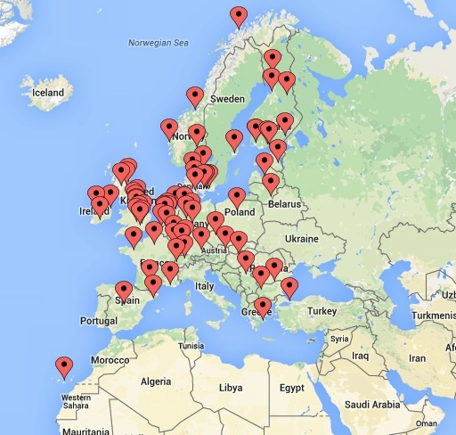
“what we do at SPARC Europe, OA policies and more” Bibliotheca Academica 2015, Ostrawa, October 13-14
Lars Bjørnshauge
SPARC Europe
Notes:
Much of what I am going to talk about now is based on work that has been undertaken in the PASTEUR4OA project. The PASTEUR4OA is as many of you know funded by the EU and aims at aligning policies within the EU membership states in line with the Horizon2020 Open Access mandate.

Slide 2
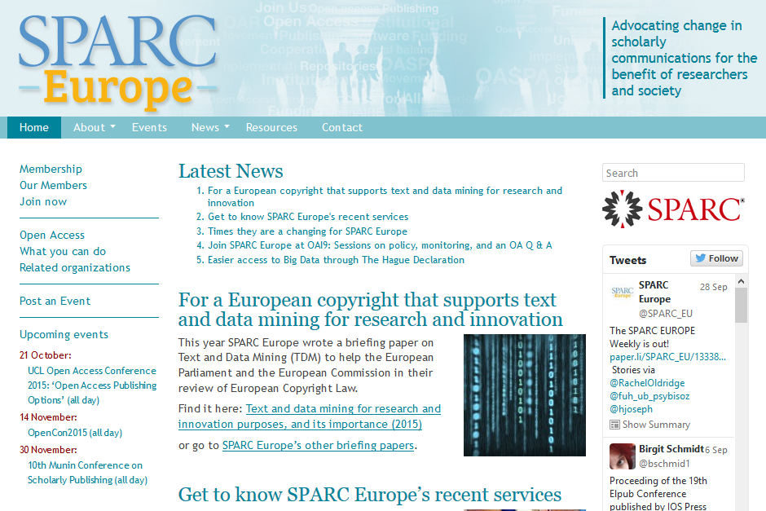

Slide 8
What we do!
Our work is focused on achieving an open scholarly communication system. We are:
Working with policy makers to influence Open Access policy development at national and European levels.
Collaborating with other organisations to build effective networks of strong voices that can make change happen.
Building a network of European Open Access advocates who want to promote the open agenda.

Slide 9
What we do!
Providing support for policy development and implementation through lobbying, policy advice, policy development tools and EU project work
Developing advocacy tools to help raise awareness about openness and to help train your researchers and students to increase access to research

Slide 10
PASTEUR4OA

Slide 11
PASTEUR4OA

Slide 12
Notes:
The work that I am concentrating on here has primarily been done by EOS (Enabling Open Scholarship), but all partners have been contributing.

Slide 13
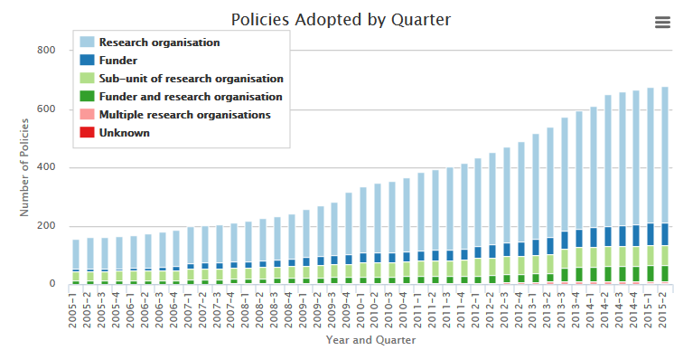

Slide 14
Open Access policies worldwide

Slide 15
Open Access mandates worldwide

Slide 16
Examining policy effectiveness
measuring deposit rates
measuring deposit latency
examining deposit rates in relation to different policy criteria
examining the correlation between deposit latency and different policy criteria

Slide 17
Deposit rates
Metadata-Only
Full-Text
Open Access
Restricted Access (embargo)

Slide 18
Strong mandates work (better than soft policies)
Deposit of Open Access material was over four times as high (14%) for institutions with a mandatory policy than for those without (3%)

Slide 19
Deposit rates and policy criteria I
Positive correlations: Open Access and Restricted Access deposit rates and these policy criteria:
Must deposit,
Cannot waive deposit,
Link to research evaluation,
Cannot waive rights retention,
Must make item Open Access

Slide 20
Deposit rates and policy criteria II
Significant correlation btwn Open Access deposit rate and
Must deposit
Cannot waive deposit

Slide 21
Deposit latency and policy criteria
Positive correlation btwn early deposit and
Age of the mandate
Cannot waive rights retention
Deposit immediately.
Significant correlation btwn early Open Access deposits and
Age of the mandate (the longer a mandatory policy has been in place, the more effective it can become).

Slide 22
An efficient policy is
A Must Deposit policy
Cannot Waive Deposit policy
A policy linked with Research Evaluation/Assessment
5 of the funder policies include these criteria - 7%
13 of the institutional policies include these criteria - 3%
Notes:
Horizon2020, FWF, HEFCE, NIH and NRF (SA) – Liege, Minho, Gent, INRIA, Luxembourg,

Slide 23
Deposit rates (institutional repositories)
Based on published articles according to Web of Knowledge in 2011-2013 measured Autumn 2014
122 institutions with mandates adopted 2011 or earlier and 10 institutions without a mandate – potentially 350.000 articles
Results:
77% had no records at all!!
8% were Metadata only
12% were Open Access
3% were Restricted Access
That is: 15% Full text!
Notes:
Pls note that this is about institutional repositories. In certain discipline subject repositories play a significant role, but in this study they are out of scope.
We all know that WoK is not the whole picture, but it should give a picture about to which extent journal articles are actually made open access via institutional repositories.
122 is 50% of the repositories where a mandate was inplace at the time of the analysis (2014) – before the makeover

Slide 24
Observations
Research Funders and mixed Funder and Research Organisations from Europe are much more likely to have stronger mandates.
No significant difference in the ”strength” of mandates in Research Organisations (Universities etc.) across the continents.
Funders are more likely than institutions to:
require deposit
recommend Gold OA and
allow and/or provide funds for APC payments

Slide 25
So far:
We have seen the characteristics of an efficient OA-policy
But the deposit rates in general are with a few exceptions depressing!
Can repositories deliver OA??
We must not forget what is was all about!

Slide 26
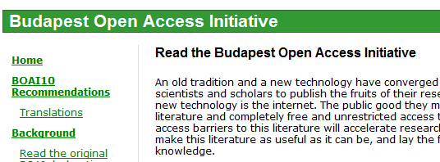
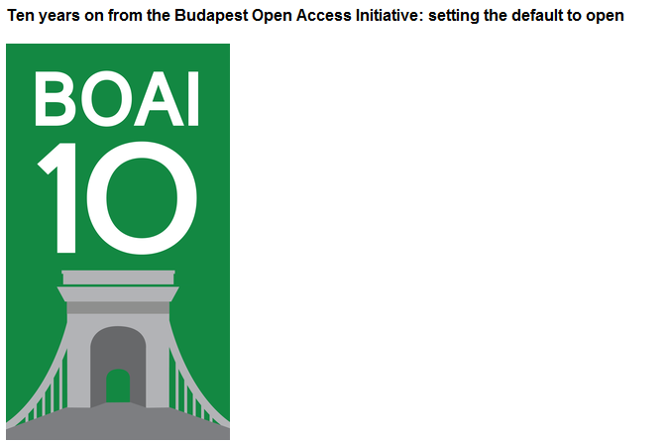
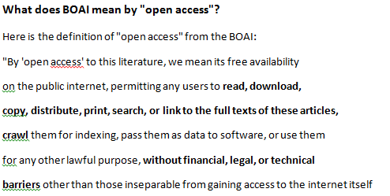

Slide 27
Open Access is…
Immediate access to published content – especially scholarly articles!
There are not many scholarly articles in the repositories.
And - embargo is a legal barrier!

Slide 28
So…..
Have we been too eager to see progress by seeking compromise and consensus??
Did we refrain from telling funders and decision makers that transition is associated with investments and costs??
Were we afraid of promoting (real) Open Access publishing (Gold – not Hybrid!!), because the are bills to be paid??

Slide 29
While we are desparetly trying to make Green OA work the publishers have regrouped their troops!
Facilitated by the UK and the RCUK they are back in business with the Hybrid stuff!
Is it time to rethink strategy? Will Green OA ever deliver the transition?
And if Green OA is coming closer to deliver, what will happen to the embargoes??

Slide 30
Trendspotting !?
Not all are that patient!
Some funders and large research institutions demonstrate more determination towards facilitating real transition:
There are updated mandates from WHO, CERN and the Norwegian Research Council and of course
Best of breed is the exiting OA-policy adopted by the Bill & Melinda Gates Foundation!

Slide 31
Bill & Melinda Gates Foundation Open Access Policy
Publications Are Discoverable and Accessible Online – promptly!
Creative Commons Attribution 4.0 Generic License (CC BY 4.0).
Foundation Will Pay Necessary (Reasonable) Fees.
Publications Will Be Accessible and Open Immediately. All publications shall be available immediately upon their publication, without any embargo period.
Data Underlying Published Research Results Will Be Accessible and Open Immediately

Slide 32
Finito!!
Lars Bjørnshauge
http://sparceurope.org
lars@arl.org

Slide 33
Useful links
PASTEUR4OA - http://www.pasteur4oa.eu/
EOS - http://www.openscholarship.org/jcms/c_5012/en/home
ROARMAP - http://roarmap.eprints.org/
The report: http://www.pasteur4oa.eu/news/109#.VSz5a5NXr-4

Slide 34
Creative Commons License
This work is licensed under
Attribution 4.0 International License
http://creativecommons.org/licenses/by/4.0/

