Slide 1
OPEN ACCESS
& KOMPLEXNÍ METRIKA
Jan Luprich
Regional Sales Manager, EBSCO
jluprich@ebsco.com

Slide 2
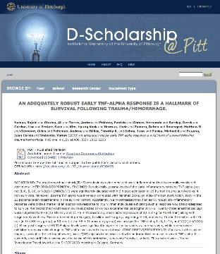
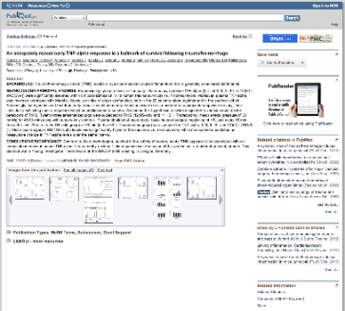
“Stejný” článek, různá místa
Notes:
“Same” article on PLOS, PubMed, and Pitt’s institutional repository.
Metrics need to be algorithmically combined from ALL places to capture all of its use.

Slide 3
Notes:
3

Slide 4
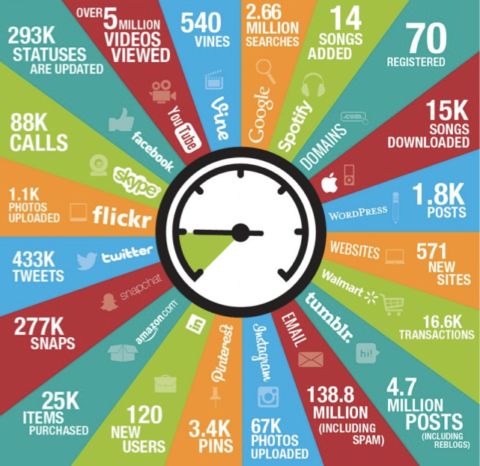
Notes:
http://colehousedigital.com/happens-online-60-seconds-infographic/

Slide 5
Plum X nad rámec tradičních citací...
Jaký dopad měl náš výzkum v posledních 12 měsících? Evaluace projektu?
Jak více pomoci vědcům v „boji“ o granty a finance pro svůj výzkum?
Jsme schopni monitorovat i ne-STEM obory a publikace neperiodických dokumentů?

Slide 6
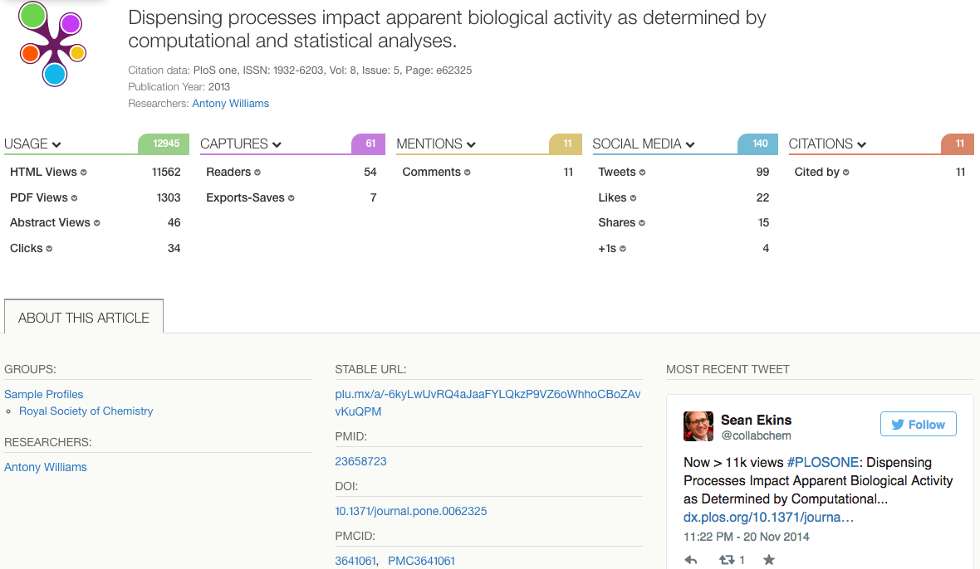
5 metrických kategorií – články, knihy, sborníky, videa, prezentace
PlumX
= metrika
v reálném
čase
Notes:
https://plu.mx/a/?doi=10.1371/journal.pone.0062325

Slide 7
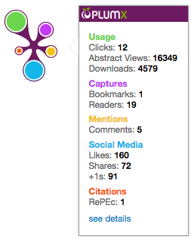
Vizualizace dopadu: Plum Print
Zahrnuje všech 5 kategorií metrik
Dynamické změny widgetu podle dopadu v jednotlivých kategoriích metrik

Slide 8
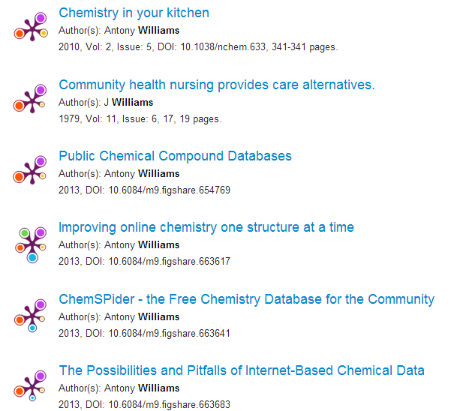
Každý Plum Print vypadá odlišně v závislosti na konkrétních metrikách
Rychlý pohled na konkrétní metriky a jejich vzájemný poměr
Možnost zahrnout Plum Prints do repozitáře

Slide 9
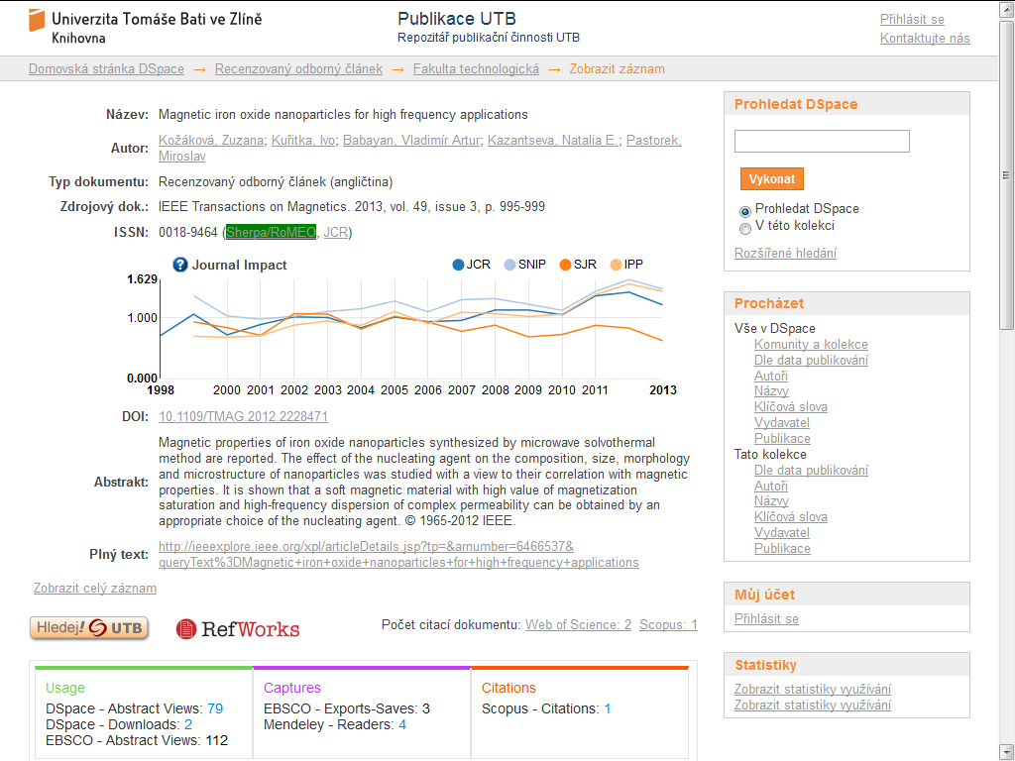
IEEE Transactions on Magnetics,
Vol. 49, Issue 3, 2013

Slide 10
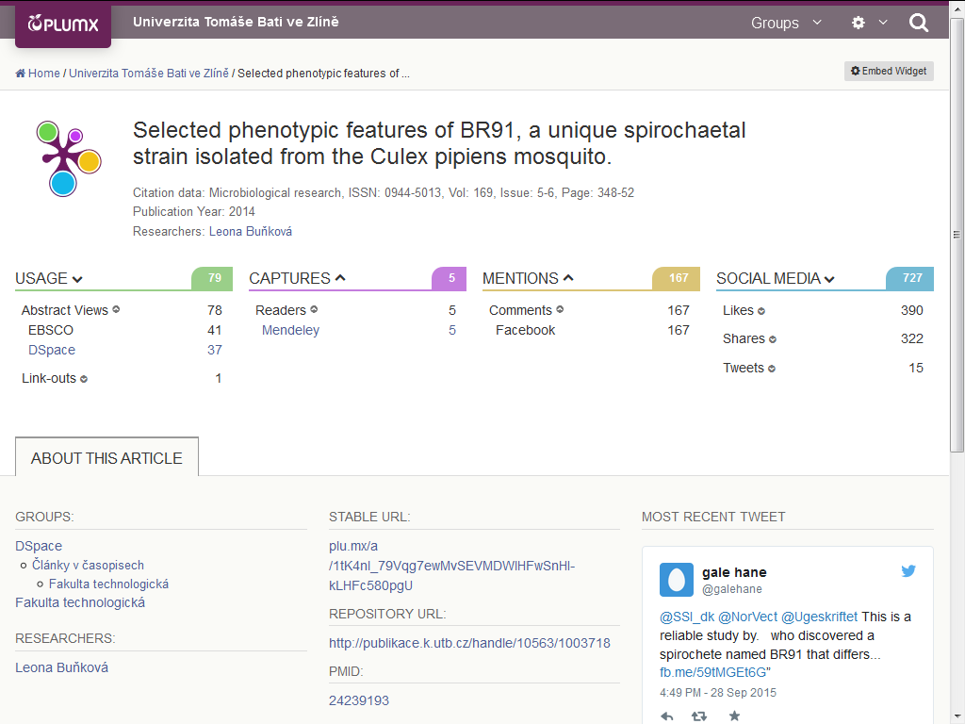
Microbiological Research,
Vol. 169, Issue 5-6, 2014

Slide 11
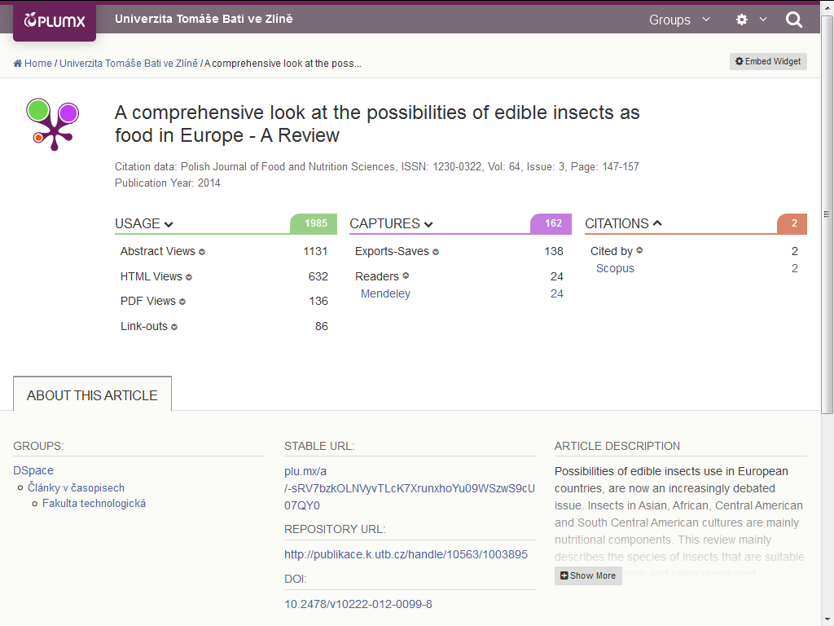
Polish Journal of Food and Nutrition Sciences
Vol. 64, Issue 3, 2014

Slide 12
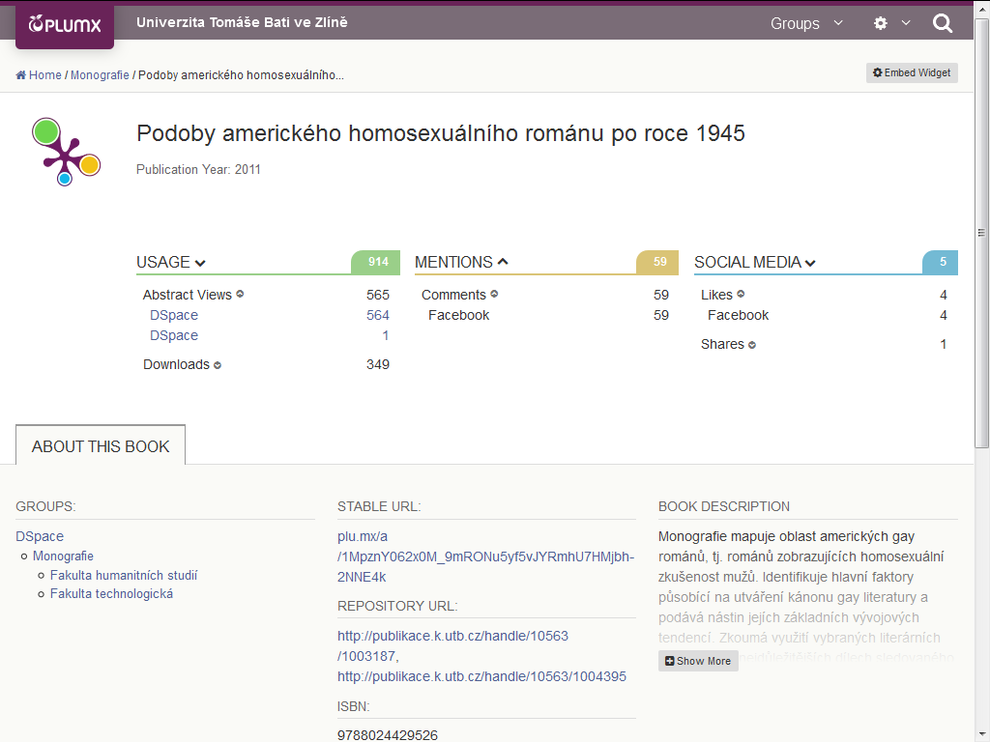
Monografie, 2011
Notes:
Roman Trušník

Slide 13
700 000+ e-knih

Slide 14
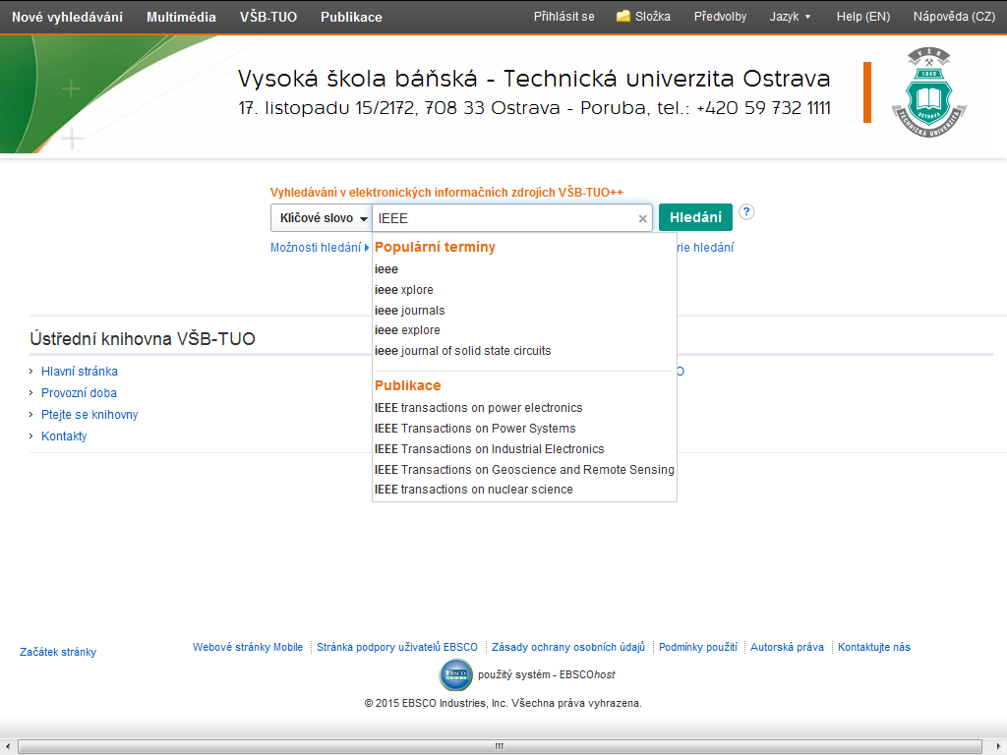
8 200+ zákazníků
MIT, Caltech, Sorbonne, VŠB-TUO...
Integrace s EBSCO Discovery Service (EDS)

Slide 15
Děkuji za pozornost
Více informací na stánku ☺
http://www.plumanalytics.com
Jan Luprich
jluprich@ebsco.com +420 739 372 642

Slide 16
Importance of IEEE to Research and Development in the Czech Republic
October 2015
Judy Brady, International Area Manager

Slide 18
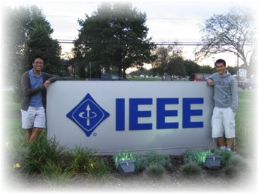
IEEE is the world’s largest professional membership association dedicated to advancing technological innovation and excellence for the benefit of humanity.
Mission statement:
The core purpose of the IEEE is to foster technological innovation and excellence for the benefit of humanity.
A mission that took a big step forward back in the year 2000…
~430,000 members in 160 countries
39 Societies
5 Core Focus Areas
Publishing
Conferences
Standards
Membership
E- Learning

Slide 19
A milestone to celebrate!

Slide 20
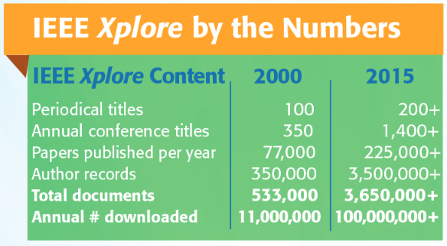
Since May 2000…

Slide 21
IEEE quality makes an impact
Thomson Reuters Journal Citation Reports® by Impact Factor
IEEE publishes:
18 of the top 20 journals in Telecommunications
17 of the top 20 journals in Electrical and Electronic Engineering
7 of the top 10 journals in Computer Science, Hardware & Architecture
7 of the top 10 journals in Computer Science, Cybernetics
3 of the top 5 journals in Automation & Control Systems
3 of the top 5 journals in Artificial Intelligence
3 of the top 5 journals in Imaging Science & Photographic Technology
2 of the top 5 journals in Robotics
The Thomson Reuters Journal Citation Reports presents quantifiable statistical data that provides a systematic, objective way to evaluate the world’s leading journals.
Based on the 2014 study released June 2015
More info: www.ieee.org/citations

Slide 22
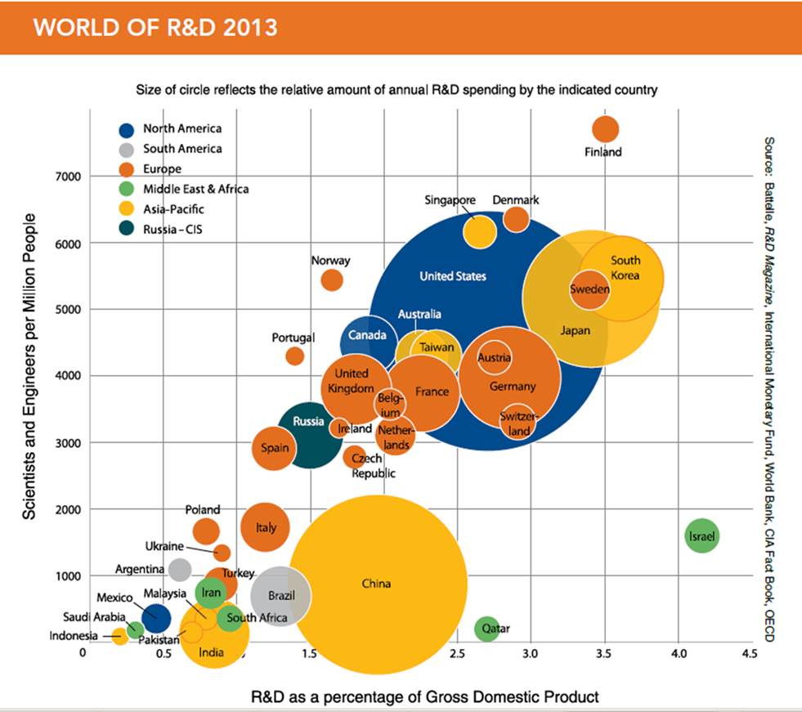
US: 2.7% R&D investment = 4% growth in GDP
Notes:
Colombia not there.
Most of South America is missing as well.
People in Room helping graduate scientists and engineers mean Colombia will be on the map soon.

Slide 23
Patent Data in the Czech Republic
311 Science & Technology patents
99 patent references to IEEE
(32% of references)
Top Patent Categories
Computer Software (121)
Measuring, Testing Control Devices (49)
Computer Hardware (46)
Telecommunications (38
Semiconductors (30)

Slide 24
Global IEEE Xplore Usage
2014 Global IEEE Xplore Usage
Europe – 18,423,433
Czech Republic Total - 201,667
Czech Consortium – 200,893
Cost per PDF
$3.26 US
Source: NetInsight + Counter Reports 2014

Slide 25
IEEE Authors in Czech Republic
Access to IEEE content helps increase boost the scholarly productivity of an institution and authorship overall
In 2004, a search of IEEE Xplore yielded a total of 1,404 articles by authors from Czech Republic
In 2014, a search of IEEE Xplore yielded a total of 8,034 articles by authors from Czech Republic
This is a nearly 472% increase in the number of articles published by authors from Czech Republic since 2004
*Results based on data from October 2015, based on affiliation search of Czech Republic in IEEE Xplore
10/13/2015
Notes:
Use author query and refine years
Beginning of time-2004
Then beginning of time to 2014
8751-1404=7347
7347/1404 = 5.23 *100 = 523%

Slide 26
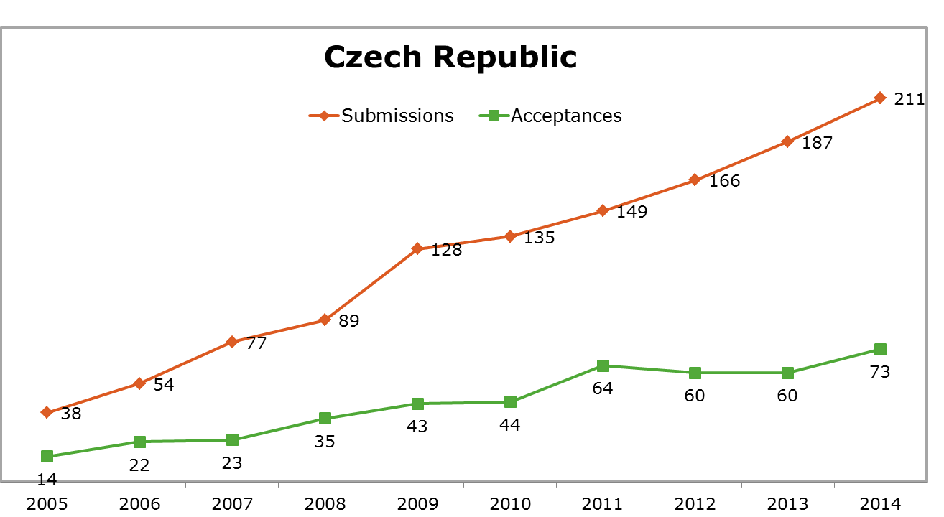
IEEE Journal Submissions and Acceptances from Czech Republic Authors (2005-2014)

Slide 27
Top Search Terms in IEEE Xplore
Cloud computing
Image processing
Data mining
Big data
Network security
Wireless sensor networks
Android
Smart grid
Power electronics
Internet of things
Source: IEEE Xplore Internal Usage Stats, 2014

Slide 28
Czech User Access Patterns
Most Highly Used Search Terms by Institutions in the Czech Republic
Hacking Cracking – 294 Searches
Uricar – 255 (author, Dept. of Radioeng’g, Czech Tech Univ. Prague)
Multi Core Processor – 214 (VLSI)
DVB-T2 – 171 (Dual Polarized MIMO Sys., Broadband Multimedia)
PMSM – 165 (Mathematical Model, Intelligent Control Sys)
Memristor – 141 (Nanotechnoogy)
Field Weakening – 132 (Control Systems)
Artificial Intelligence – 128
Comparative measurements of piezoelectric coefficient – 101 (Ultrasonics & Ferroelectronics)
Quadrotor – 100 (Control Systems)
Source: Net Insight Reports

Slide 29
Czech Researchers Attempt to Use Unsubscribed Content in IEEE Xplore
2014
661 – 2014 Total Denials
IEEE / Wiley eBooks - 267
IBM Journal – 201
MIT eBooks - 77
IEEE Draft Standards – 75
MIT Press Journals – 41
2015 Morgan & Claypool – 44 YTD
2015 through July - 481 Denials
Estimate 800+ by year end
2016 IBM Journal Subscription $1,285 USD
Source: MPS Reports 2014

Slide 30
eBooks Collections in IEEE Xplore
IEEE-Wiley eBooks Library
More than 700 eBook titles from the Wiley-IEEE Press
Backfile to 1974
Added to IEEE Xplore in 2010
MIT Press eBooks Library-Computing & Engineering Collection
Nearly 600 eBook titles from the MIT Press with more than 70% of titles in computing related fields
Backfile to 1943
Added to IEEE Xplore in 2012
Morgan & Claypool Synthesis eBooks Library
Access nearly 700 peer-reviewed titles focusing on computer science
Backfile to 2006
Added to IEEE Xplore in 2014
Perpetual access options available for all collections
Pricing options ranging from MIT eBooks lease $5,495 up to Wiley eBooks Perpetual $21,495

Slide 31
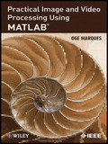
IEEE-Wiley eBooks Content
Cutting-edge titles on emerging technologies, authored by leaders in the field
The library includes:
practical handbooks
introductory and advanced texts
reference works
professional books
The eBooks collection spans numerous content areas including Bioengineering, Power & Energy and Communication technologies

Slide 32
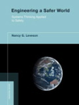
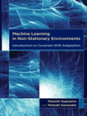
Content Enhancements
MIT Press eBooks Content Areas
The collection of titles includes titles with an emphasis on leading areas of applied research, such as:
Bioengineering
Communication, Networking, and Broadcasting
Components, Circuits, Devices, and Systems
Computing and Processing
Engineered Materials, Dielectrics, and Plasmas
Engineering Profession
Fields, Waves, and Electromagnetics
Geoscience
Power, Energy, and Industry Applications
Robotics and Control Systems
Signal Processing
Transportation

Slide 33
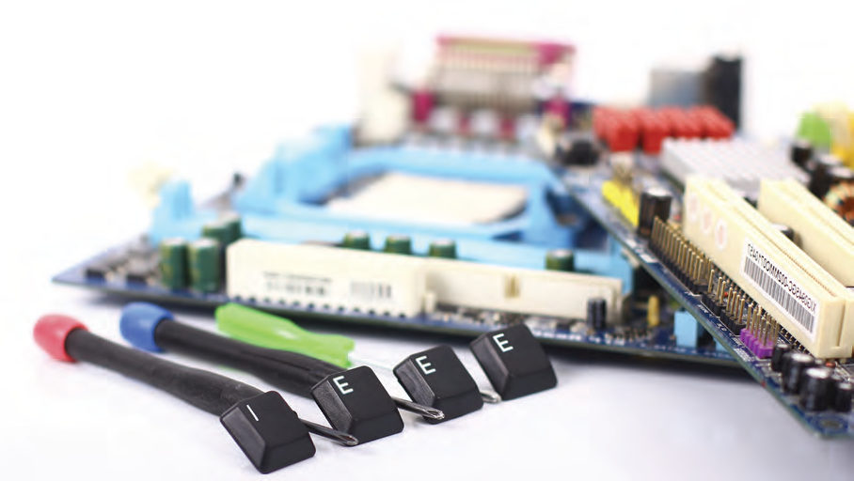
Morgan & Claypool Synthesis Library
IEEE has partnered with Morgan & Claypool Publishers to bring the Morgan & Claypool Synthesis eBooks Library to the IEEE Xplore Digital Library.
Nearly 700 eBooks that synthesize an important research or development topic, authored by an expert contributor to the field.
Provide more analysis and depth in the format of an 80- to 140-page book as opposed to a typical research article.
SYNTHESIS is organized by series, each managed by a prominent consulting editor.

Slide 34
Sample Synthesis Subjects

Slide 35
M&C Synthesis eBooks Library Content
Synthesis is an innovative information resource for the research, development, and educational community in engineering and computer science
Focuses on applied material content, not primary research with a goal to help engineers learn “how to do things”
Synthesis collection covers the following years through its current five collections:
Collection One: 2006-2007
Collection Two: 2008-2009
Collection Three: 2010-2011
Collection Four: 2011-2012
Collection Five: 2013-2014
Collection Six: 2014-2015
Collection Seven: (coming soon)

Slide 36
IEEE eLearning Library: Improved and Newly Released in Xplore
Courses are peer-reviewed, updated and developed by experts
Each course must pass a rigorous review process by IEEE societies and experts, as well as faculty from renowned corporations and universities worldwide.
An editorial board updates existing content regularly to ensure it remains current.
Categorized by topic with extended series’
All courses are presented in topical categories ranging from Aerospace to Transportation. These topics now correspond exactly to the 16 subject areas in IEEE Xplore.
Tutorials can be filtered by sub-topics for better discovery precision.

Slide 37
FREE Courses for Universities in 2015
Most Highly Used Search Terms:
Cloud Computing
Big Data
Smart Grid(s)
Internet of things
Free Courses IEEE has made five courses available for free until 31 Dec 2015.
Cloud Based Solutions for Big Data: http://ieeexplore.ieee.org/courses/details/EDP405
Cloud Computing Enabling Technologies: http:// ieeexplore.ieee.org/courses/details/EDP384
4G Broadband LTE: http:// ieeexplore.ieee.org/courses/details/EDP378
Transportation Electrification: Applications of Electric Drive Trains: http:// ieeexplore.ieee.org/courses/details/EDP370
Smart Grid: From Concept to Reality: http:// ieeexplore.ieee.org/courses/details/EDP212
Demo Webinars (June 2015) By George Plosker Recording Available https://ieee.webex.com/ieee/ldr.php?RCID=39a43faa94f5f000e4643657b050509
Free Trials
Contact EBSCO to set up your free trial of the full collection
More info http://innovate.ieee.org/innovate/industry/corporations/whats-new/New%20Features/article/123678

Slide 38
Thank you!
Judy H Brady, IEEE Area Manager, Europe
email: J.brady@ieee.org
IEEE’s Exclusive Representative in the Czech Republic
EBSCO Information Services
Tomáš Bačík, Territory Subscription Specialist
phone: +420 234 700 640
mobile: 734 808 308
email: Tbacik@ebsco.com
Klimentská 52 110 00
Praha 1 - Czech Republic

Slide 39
Key sites to remember
IEEE Author Tools IEEE.org/go/authorship
IEEE Conference Search and Calls for Papers: http://www.ieee.org/conferences_events/index.html
IEEE Xplore: http://ieeexplore.ieee.org
IEEE Xplore information, training and tools: http://www.ieee.org/go/clientservices
IEEE Journal Citation reports: http://www.ieee.org/publications_standards/publications/journmag/journalcitations.html

Slide 40
eBooks FAQs
Are their MARC records for the eBook collections?
Yes, IEEE provides MARC records for all eBook collections in IEEE Xplore free of charge to customers.
MARC records for the Wiley and MITP collections are available via OCLC while M&C Marc records are available via the M&C website: http://www.morganclaypool.com/page/ieeemarc
Where can I find the most recent list of titles?
The OPAC list in IEEE Xplore contains the current list of titles available in IEEE Xplorehttp://ieeexplore.ieee.org/xpl/opacbooks.jsp
Where can I find a list of forthcoming titles?
Lists of forthcoming titles are updated throughout the year as our partners provide information. These can be found in SFDC/Dealer Portal in the Documents tab in the MKTG: eBooks/Online Learning Materials folder.
Note, these title lists are tentative as titles may be added/moved to future years depending on our publishing partner's publication schedule and their authors.

