Slide 1
ProQuest update
Bibliotheca Academica, 2014
Vedecka knihovna Univerzity J.E. Purkyne v Usti nad Labem
Jakub Petrik, Albertina icome Praha
Krzysztof Murawski, ProQuest

Slide 3
A long history of partnering with libraries
1872 – 1876 – R.R. Bowker launches Publishers Weekly and Library Journal
1932 – R.R. Bowker launches first periodicals directory
1948 – First edition of Books in Print launches
1951 – UMI launches dissertations service
1968 – Bowker named U.S. ISBN Agency
1979 – Cambridge Scientific Abstracts launches Medline CD-ROM
1996 – UMI goes online under ProQuest Direct
1998 – Library of Congress names UMI the official repository for American dissertations
1999 – ebrary and EBL pioneer the ebook industry
2000 – Serials Solutions is founded, by a librarian
2001 – Historical Newspapers launches with digitization of the New York Times
2004 – Serials Solutions joins ProQuest Information and Learning
2007 – ProQuest Information and Learning becomes ProQuest
2011 – ebrary joins ProQuest
2011 – ProQuest announces Intota
2013 – EBL joins ProQuest
Notes:
Speaking Notes
We have been partnering with libraries to deliver greater value for more than 75 years. Let’s take a quick look at our history.

Slide 4
Jeden ProQuest
ProQuest
SerialsSolutions
RefWorks
Bowker
Chadwyck Healey
Ebrary
Ebook Library (EBL)
Dialog
University Microfilms
jeden

Slide 5
Electronic books

Slide 6


Combined Ebook Platform
LibCentral
Choice
LibCentral
Advanced Reporting
& Librarian tools
Innovation
Content
Management System
Integration
Complete Patron UI
New Reader
Support
New
Reader
6

Slide 7
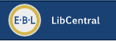
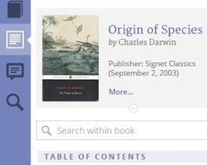
ebrary & EBL Integration Roadmap Timeline
Nov – Dec
Improved Invoicing for EBL customers
New EBL LibCentral
Improved & sophisticated librarian functions
EBL Enhancements
Three-user license
New access permissions (May)
Mid - Late 2013
Early 2014
Mid 2014
Late 2014
Mid 2015
Combine ebrary & EBL Content and Publisher Agreements
Content Updates for Combined Platform
New ebrary Reader
Modern design & intuitive navigation
Target release for
Combined Ebook Platform
= launched
7

Slide 8
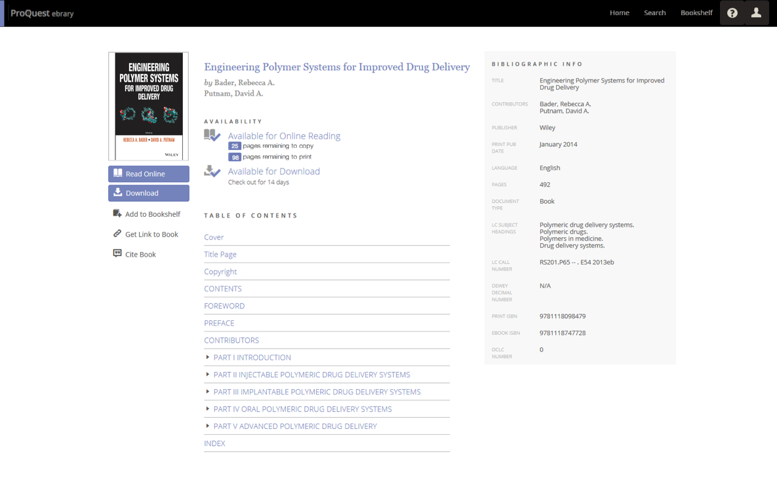
Reader Preview – new Detail page (patron view)
8
Notes:
We’re developing a new Detail page, similar to EBL’s current “Full record” page. From search results, researchers can:
select a title and gain valuable info about the book that helps them determine what they want to do next.
In this example, a single-user title was selected, so the patron is informed that there is one copy remaining for use…as well as learning its availability to read online or download, and their copy and print options.
Bibliographic data and the TOC are both very easy to find and quickly skim.

Slide 9
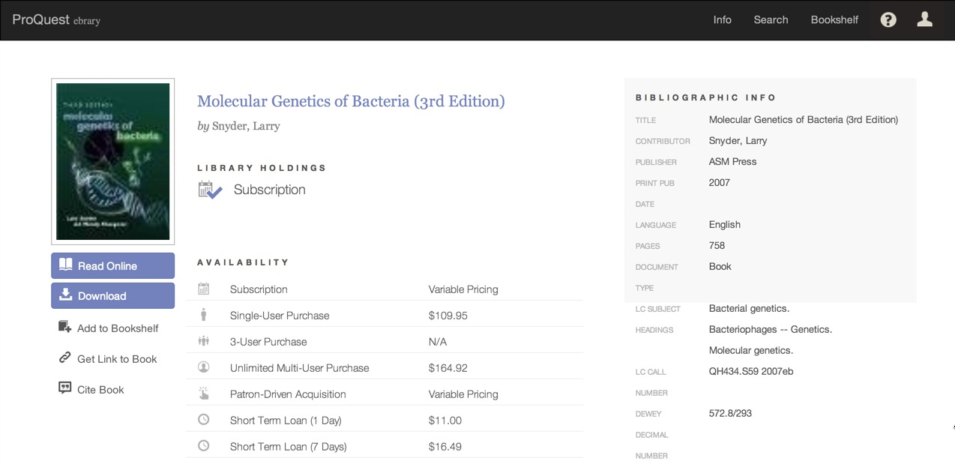
Reader Preview: Detail page, Admin view

Slide 10
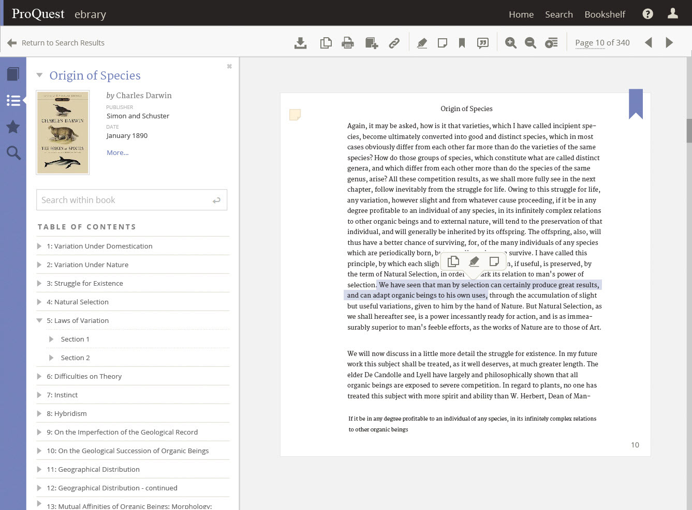
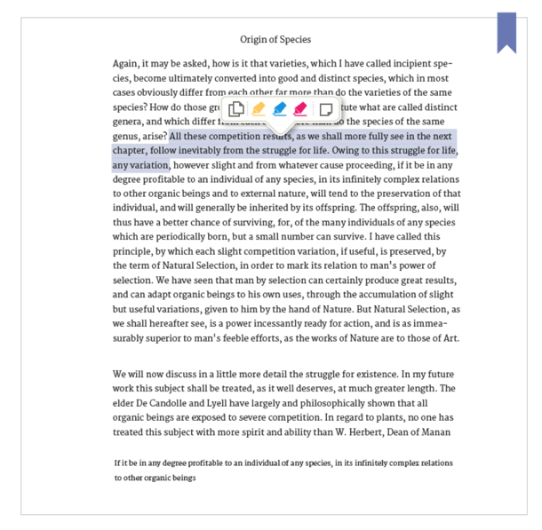
Reader Preview - on opening book
10
Notes:
When a patron first opens a book in the new Reader, this is what they see.
Early user feedback has been how valuable it is to have Search within the book and the TOC very accessible, as they are the 2 most frequently used functions when a researcher is trying to determine if this book will be helpful with their research.
Text selection has been improved – the patron receives instant feedback on a word by word basis on what they have selected.
Navigation options for the viewing pane are 4 fold—continuous scroll, forward/back, entering a specific page number, or using the TOC to navigate.
The side panel can also be dismissed, to increase the size of the viewing pane.
And we’re testing on tablets as well as laptops larger displays, to ensure a great user experience across the spectrum of display sizes.

Slide 11
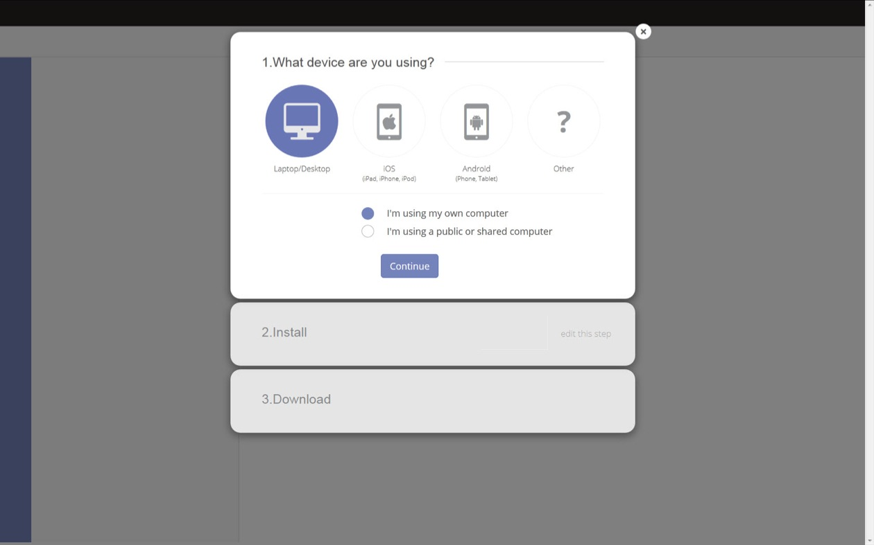
Reader Preview – download: guided 3 step flow

Slide 12
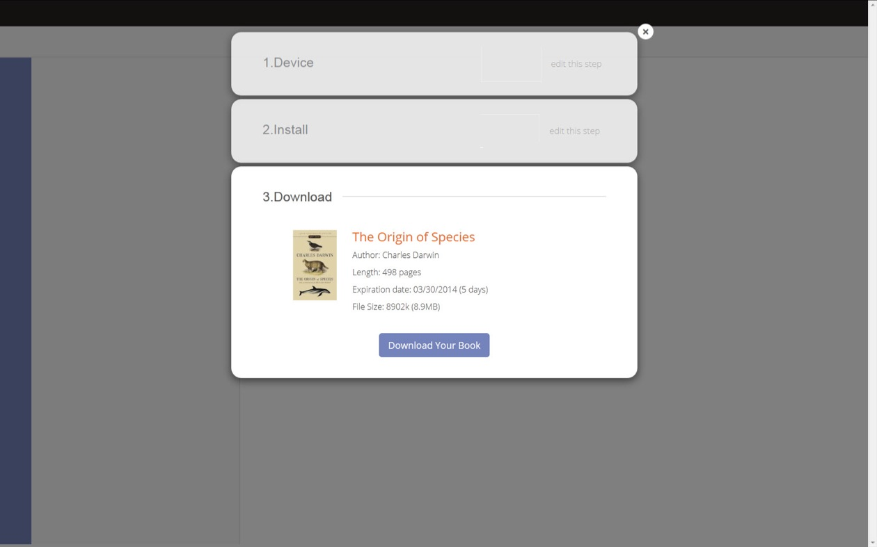
Reader Preview – download: Step 3

Slide 13
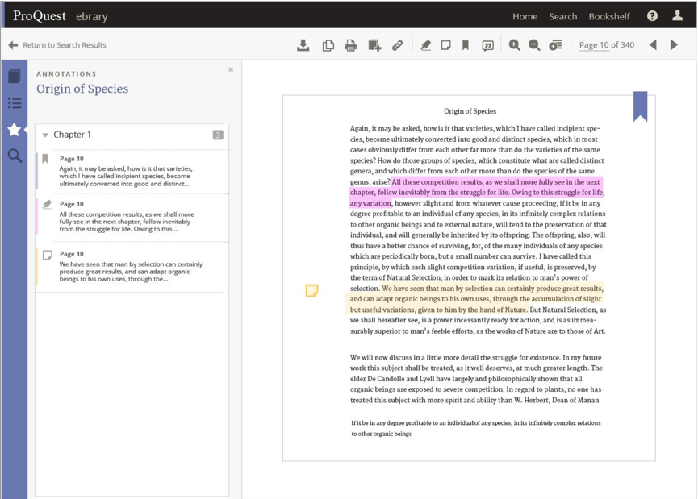
Reader Preview – bookmarks, highlighting, notes

Slide 14
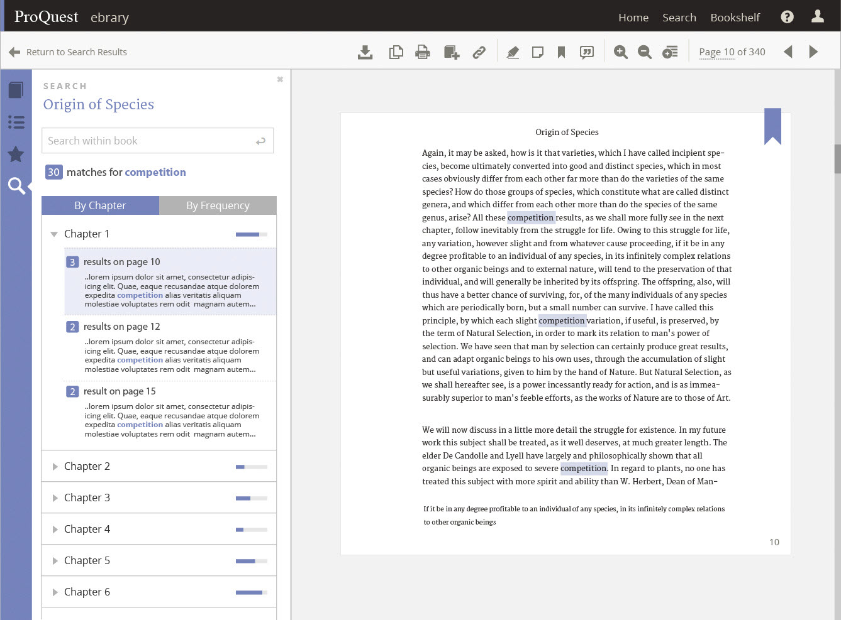
Reader Preview – search within book
14
Notes:
Here’s an example of Search results within the book
the default view is the results are displayed by chapter, giving the researcher a quick visual on which chapters have the heaviest usage of the search word or phrase.
They can immediately click on a chapter (in this example, chapter 2 is expanded) to see the results within the chapter, in context.
Popping over to the “By Frequency” tab gives a view of top pages for the search, ranked highest to lowest across the book as a whole.

Slide 15
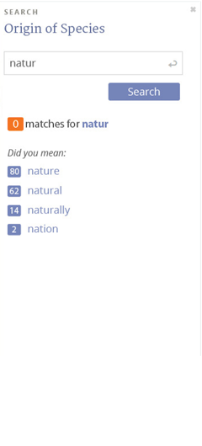
Reader Preview – search “did you mean?” enhancement
15
Notes:
Here’s an example of Search results within the book
the default view is the results are displayed by chapter, giving the researcher a quick visual on which chapters have the heaviest usage of the search word or phrase.
They can immediately click on a chapter (in this example, chapter 2 is expanded) to see the results within the chapter, in context.
Popping over to the “By Frequency” tab gives a view of top pages for the search, ranked highest to lowest across the book as a whole.

Slide 16
ProQuest dissertations and theses global

Slide 17

PQDT Global
PQDT Full Text
2.7 million A&I records
1.7 million Full-Text
70,000 new full-text dissertations & theses a year
PQDT UK & Ireland
560,000 A&I records
16,000 new A&I per year
New European Content
15,000 new theses per annum
100,000 new A& I
Together this equals PQDT Global
90,000 new full-text theses & dissertations per annum and 100,000 new A&I records
Added to current files of more than 3.2 million A&I records and 1.7 million full-text works
Notes:
These core collections are a common foundation from which academic and research libraries around the world are building a strategic partnership with ProQuest.
Together we can build confidence in research process—enhancing your library’s value as it delivers on better research outcomes for everyone you serve.
NOTES
Launch scheduled for September 2013
5,400 UK D/T at launch with 9,600 still to come in 2013
Pricing even more attractive than PQDT FT in most cases. 23,600 Tier 3
6 initial partners; another 5 in 2014
Year span 1990-pres.
Includes color and MM files.

Slide 18


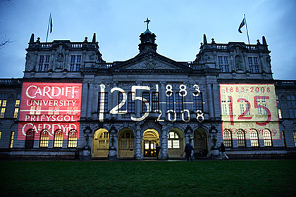

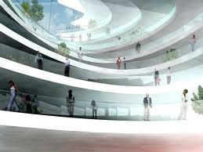

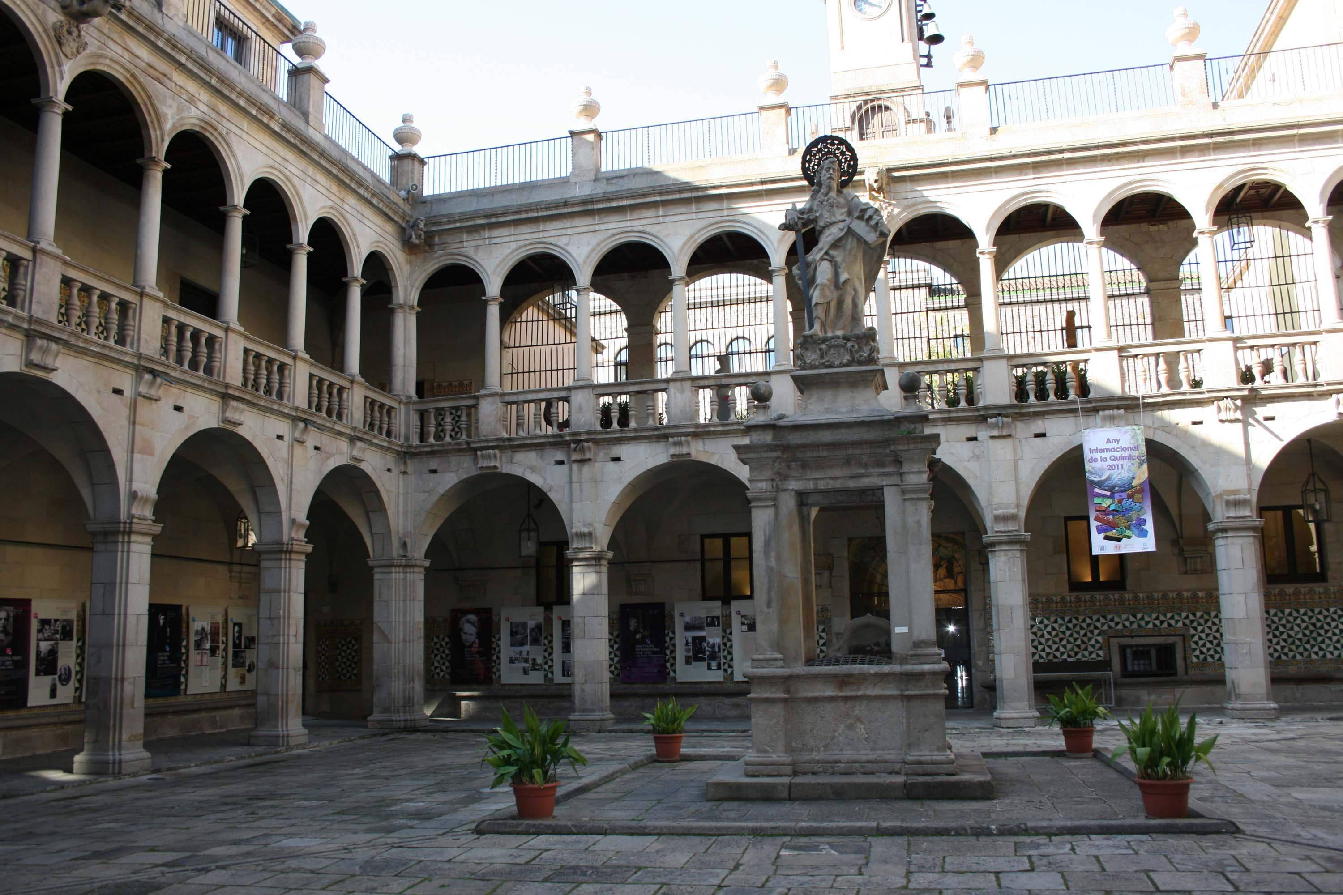


PQDT Global : new European content
A vision to connect people to the world’s knowledge
University College London
Cardiff University
University of Aberdeen
University of Leicester
University of Bath
Universitat de Valencia
London School of Economics
And more to come….
Notes:
Behind it all you can know it’s backed up by a reliable, trusted library partner.
The “ProQuest Story” began seventy-fiver years ago as we teamed with libraries to connect individuals to the world’s knowledge. Our common goal: remove the barriers between people and information. We set out to preserve content and make information that had previously been available to only a few much more accessible.
It started with our founder, Eugene Power, who early in his career sought ways to extend, preserve, and facilitate the reach of information through innovative, landmark programs as:
Filming and cataloging 6 million pages of rare/valuable books and manuscripts from various libraries and museums in England
Producing the first The American Periodical Series, which consisted of microfilm reproductions of all extant magazines published in the US from 1741-1799
Filming and archiving the full, complete run of The New York Times, a publishing partnership since the 1940s
And continues today, with releases like the American Vogue Archives.
http://faculty.libsci.sc.edu/bob/ISP/uminc.htm
http://www.nytimes.com/1993/12/09/obituaries/eugene-b-power-88-a-pioneer-in-microfilm.html

Slide 19
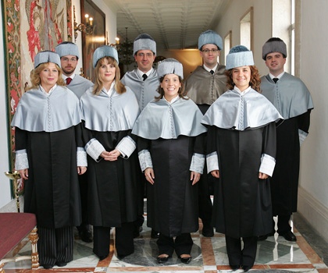
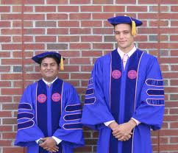
Value Proposition
Offers previously unavailable content from Russell Group and other leading institutions across all disciplines.
Allows quick and seamless discovery and access hard-to-find international dissertations which are otherwise scattered in thousands of institutional repositories.
Save time, costs and resources required to find and get dissertations via ILL.
Dissertations can be searched together with other leading academic content sources in ProQuest’s powerful research environment.
Models work of other leading institutions for graduate students.
Notes:
It’s because of our specialized expertise in library management and discovery solutions that has developed innovative services like the Summon Service – now used in over 500 global academic research institutions as the digital front door to the library.
Unlike others, Summon is proven to increase usage of resources across the full breadth of a library’s collection without bias to publisher, vendor or content type.
And, it’s the only one with a unified index of content, helping to expose users to more resources than other services and to enable new dynamic ways to discover content.

Slide 20

INTOTA™
Discovery, Management and Assessment for a Transformed Library

Slide 21
Your collections have transformed, now it’s time to transform the way you manage those collections.

Slide 22
Biggest Pain Points
Workflows
System Maintenance
Assessment

Slide 23

Can Available Systems Address Your Needs?
New offerings built on old workflows
Not true multi-tenant SaaS
Not networked
Don’t address your biggest challenges
Intensive migrations
Notes:
So, the question is, can you change your workflows, transform your priorities using the tools at hand?
Existing ILS replacements are essentially offerings that are built on old workflows. – the old model in the cloud.
They are not true SaaS solutions They are a mix of architectures or pieces bolted onto older systems. They are not networked – networked systems, such as direct access to campus systems for student and finance or online access to bibliographic data, offer efficiencies that you should have – reduce staff training, and keep your data synched. Think what Amazon would be like if it worked like our library systems work, with batch processes for everything.
Finally, they often require intensive migrations. Rather than addressing your biggest pain points, , they force you to go “on hold” as you work through a cumbersome migration that disrupts your growth, affects your patrons and ultimately doesn’t give you a base to BUILD on.

Slide 24

The Pillars of Intota
Comprehensive Knowledgebase
Complete Collection Assessment
Unified, Intelligent Workflows
Industry-Leading Discovery & Linking

Slide 25
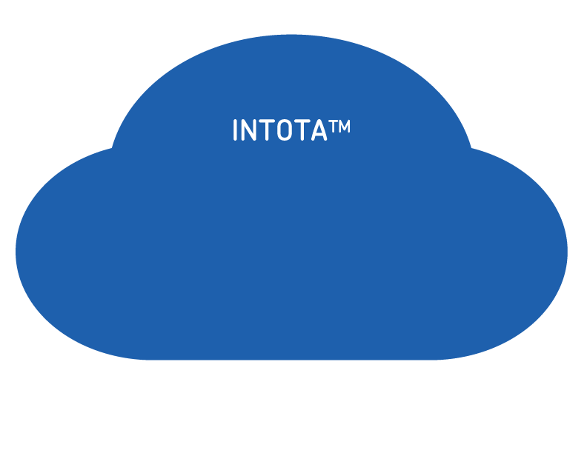

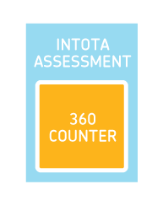


Intota 2014 Mid-Year Release

Slide 26
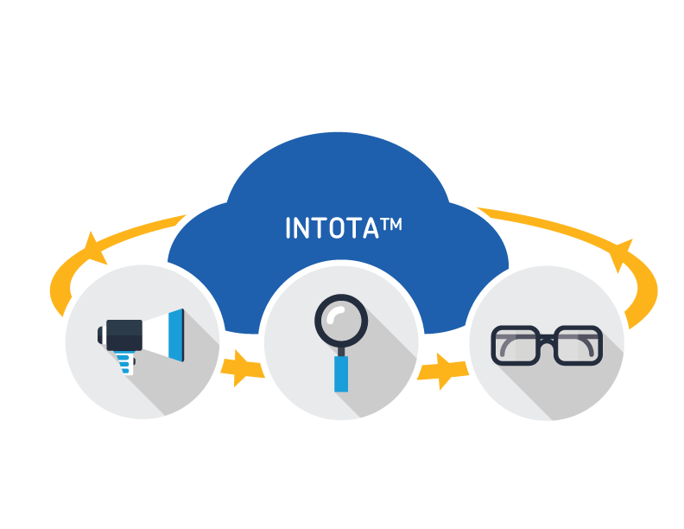
Core Functionality Today
Manage
Unified management system makes DDA easy
Fit as part of your total inventory
Discover
Minimal time and effort to make discoverable
Offer the best discovery experience
Assess
Evaluate for profiling and purchase decisions
Easily demonstrate ROI of programs and show success

Slide 27
Proquest flow

Slide 28
FLOW
Institutional version vs free individual access
Integration with ProQuest Platform
Integration with Summon 2.0
Integration with MS word
Integration with Google docs

Slide 29
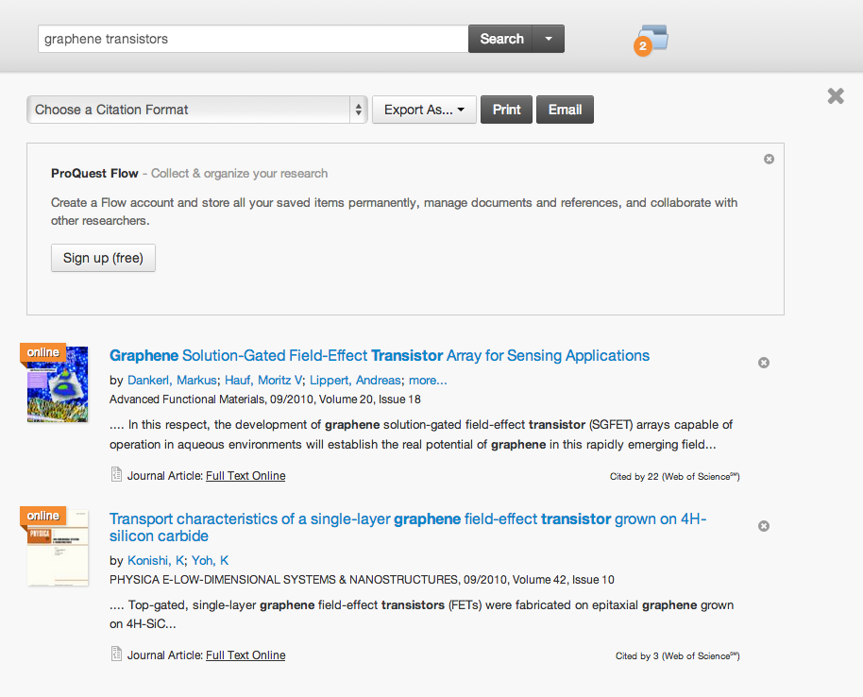
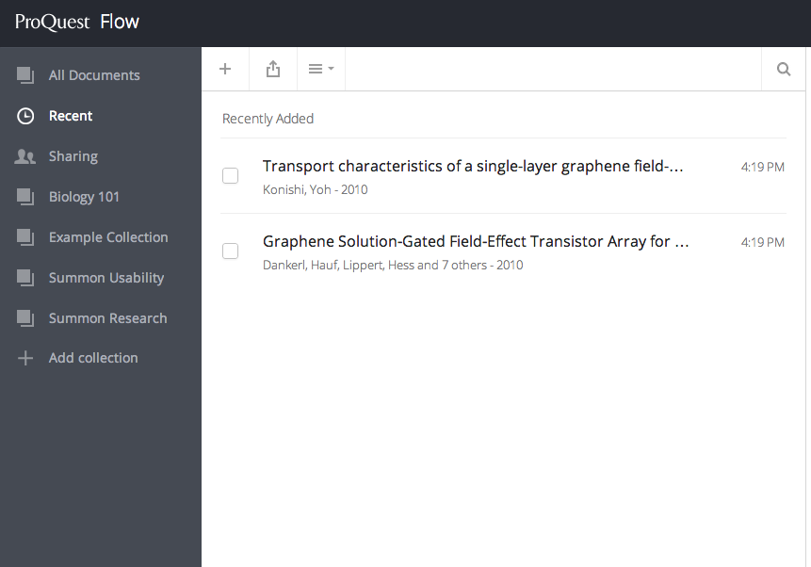
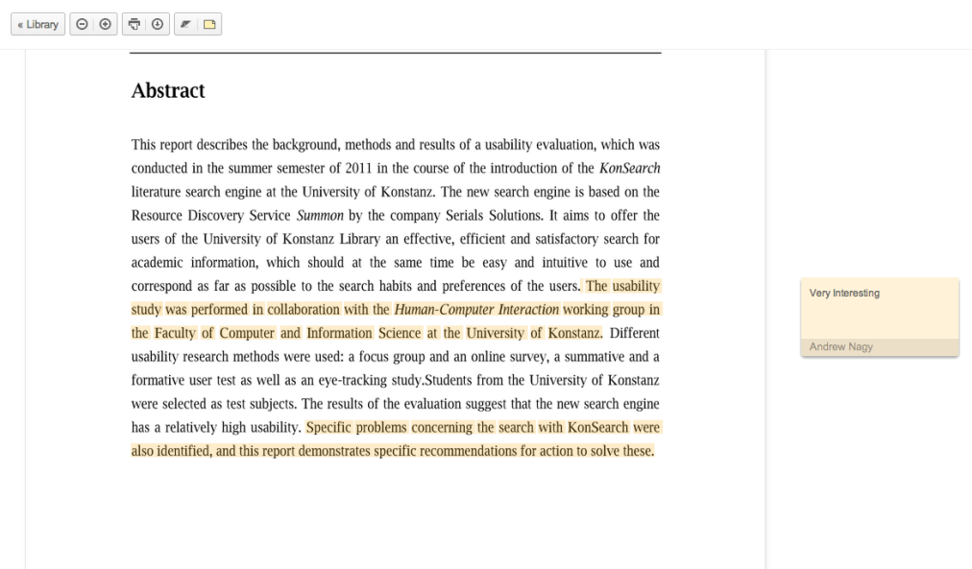
Integrated Reference Management
Discover Save Share Collaborate

Slide 30

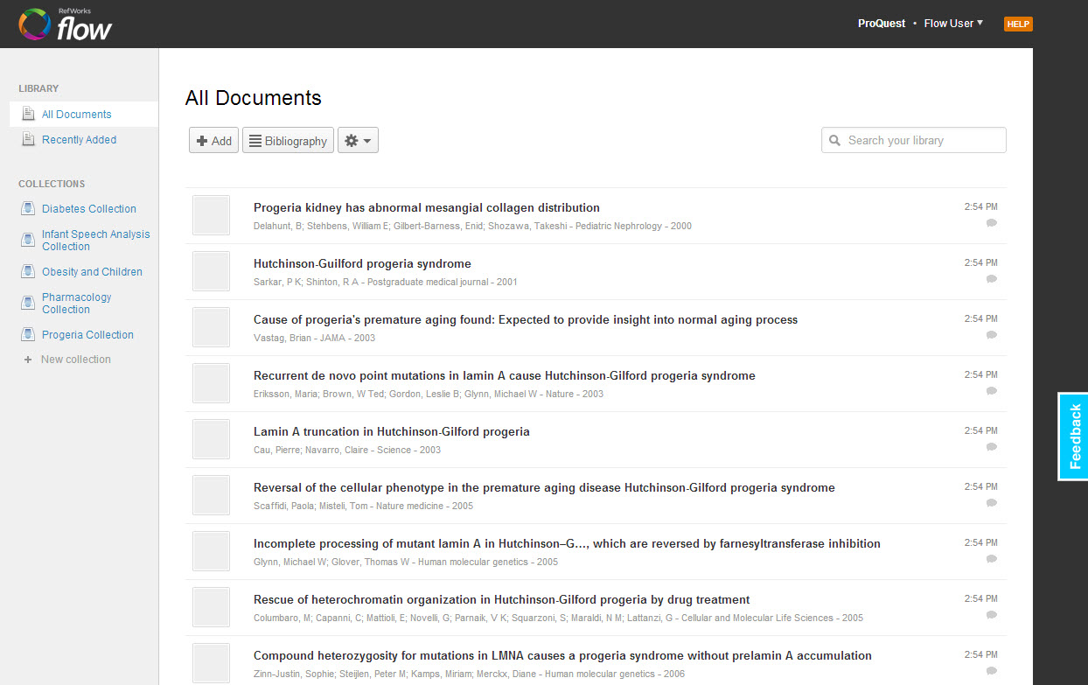


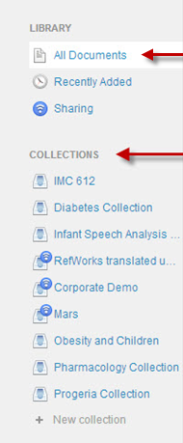
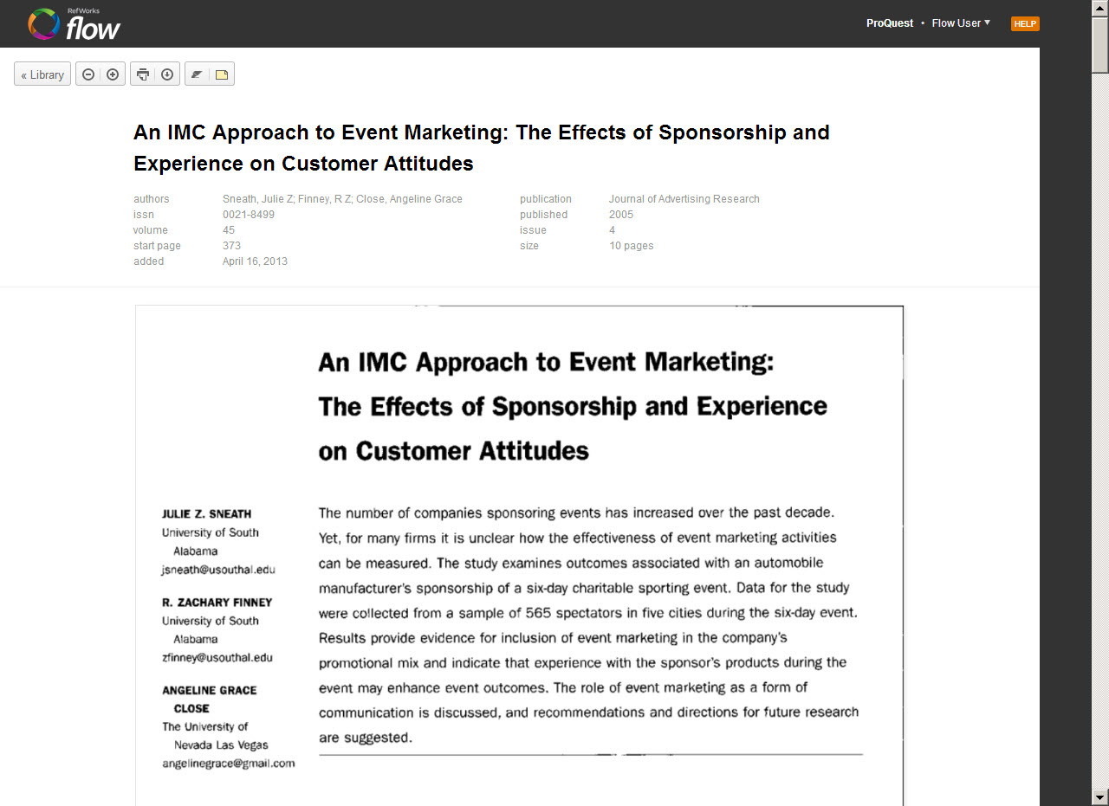
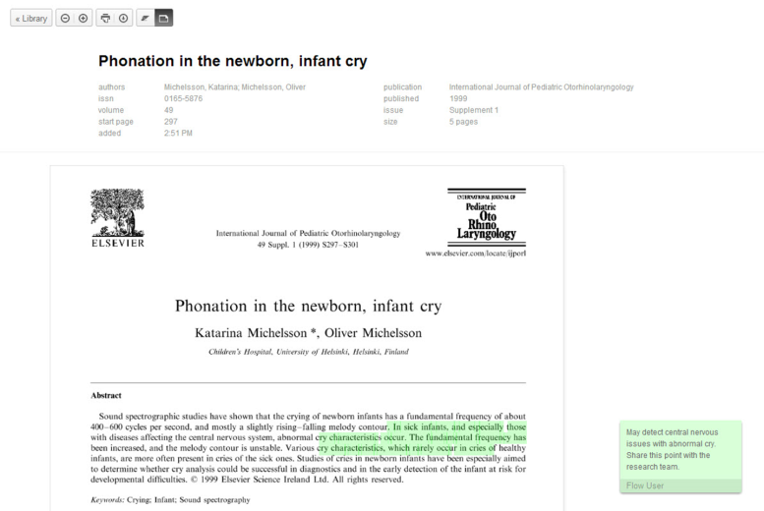

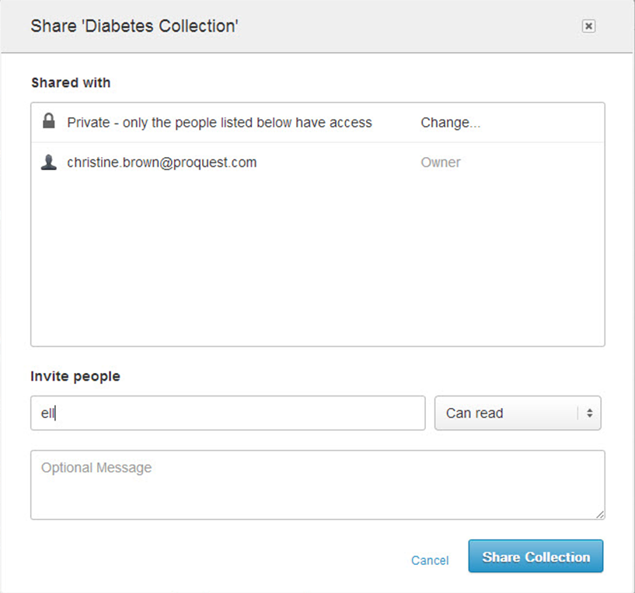

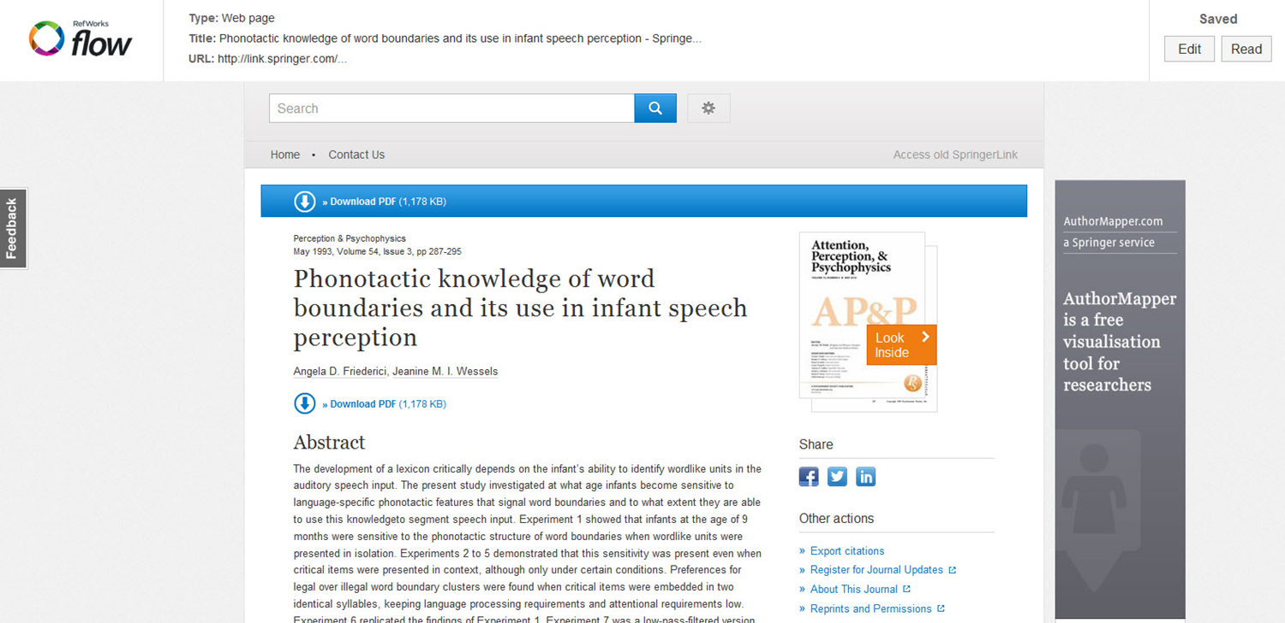


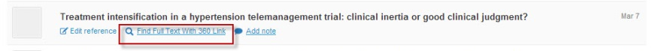
A Research Workflow That’s Now Digital
CLOUD-BASED
STORAGE
SAVE TO
FLOW
COLLABORATION
READ
FULL-TEXT
INTEGRATION WITH WORD
ANNOTATION
Notes:
More than ever, users have both full-text materials and references and they are engaged with both. We aim to help users join those two together and make RefWorks into their personal service that helps them keep both organized and helps them generate bibliographies or use for collaboration purposes. We really took into consideration the changing usage patterns and changing perceptions of technology.
Researcher’s documents are born digital – yet many research tools still artificially separate the citation from the document itself.
As users spread their work across multiple devices their personal documents move to the cloud. But where do their research documents go, and how do they collaborate on them?

Slide 31
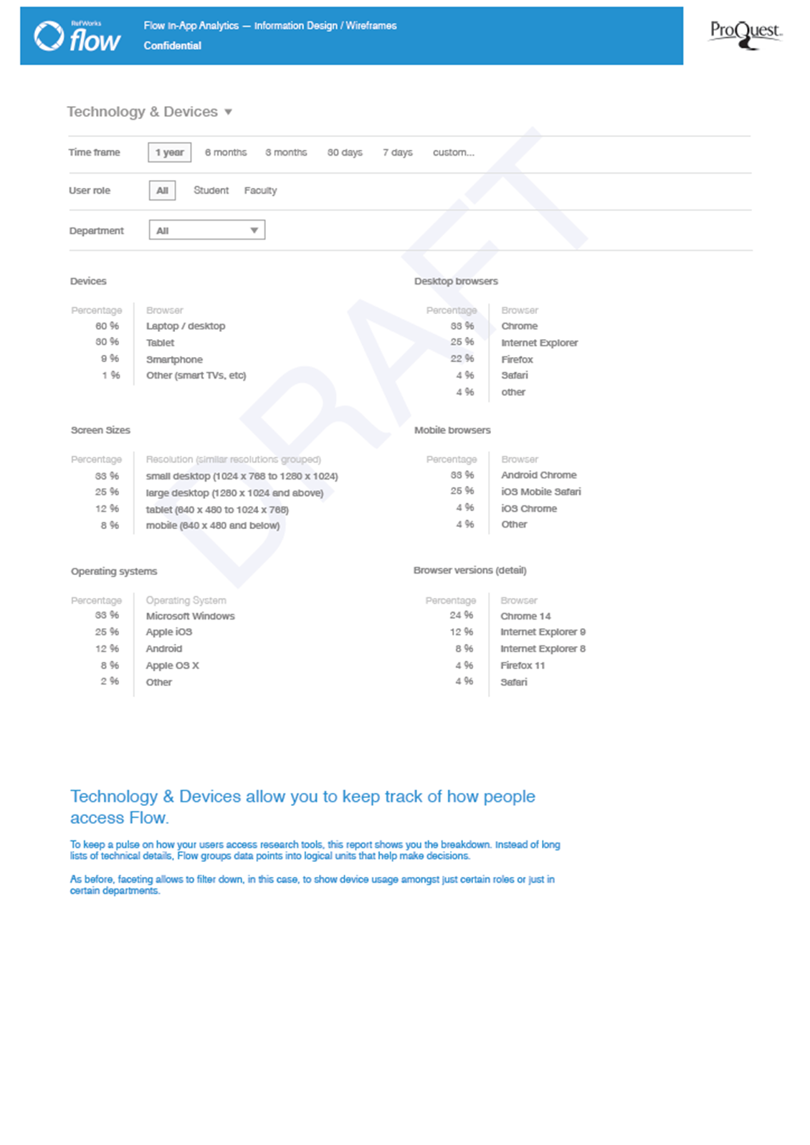
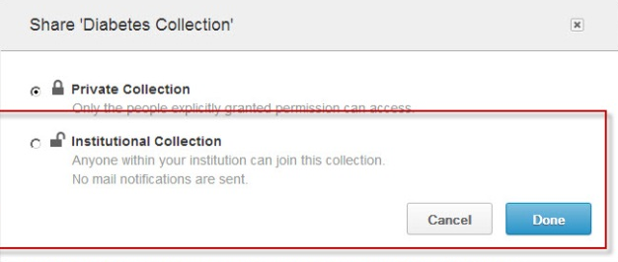

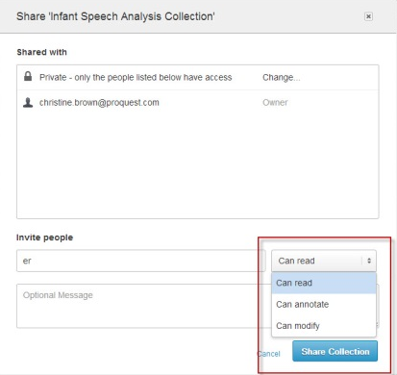



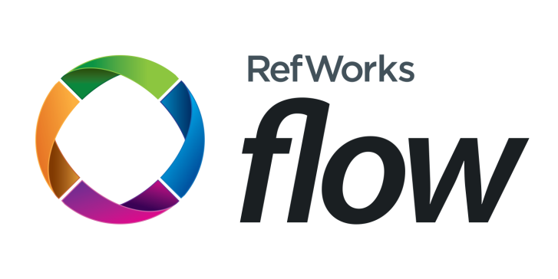





How Does Flow Bring Value to the Library
  Service Representative
INSTITUTIONAL
SHARING
SENSITIVITY TO
COPYRIGHT
ACCESS
FULL TEXT
  Service Representative
ANALYTICS
SUPPORT AND SERVICE
MANY POWERFUL CAPABILITIES
Notes:
More than ever, users have both full-text materials and references and they are engaged with both. We aim to help users join those two together and make RefWorks into their personal service that helps them keep both organized and helps them generate bibliographies or use for collaboration purposes. We really took into consideration the changing usage patterns and changing perceptions of technology.
Researcher’s documents are born digital – yet many research tools still artificially separate the citation from the document itself.
As users spread their work across multiple devices their personal documents move to the cloud. But where do their research documents go, and how do they collaborate on them?

