Slide 1
Libraries: Doorway to the past and key to the future
Professor Emeritus Derek Law,
University of Strathclyde
Notes:
Libraries have existed for three thousand years as storehouses of the knowledge of mankind. That knowledge has been managed, recorded and preserved by librarians. Universities are a more modern mediaeval development and have been concerned with both the creation of knowledge as well as its transmission. Libraries and universities have shared a symbiotic relationship which becomes ever tighter as we move into a digital era. The paper will explore the changing nature of information, the growth of the huge global information companies such as Google (but also the gaps they leave) and the important role that libraries and librarians will continue to play as intermediaries, data miners, teachers of information literacy, managers of institutional IP and curators of digital content, who will aggregate and add value to the material created by academic colleagues.
It is exactly 29 years since I first visited what was then Czechoslovakia, undertaking a tour of medical libraries under what was known as the Helsinki Agreement. The declaration focused on improving the relations between Communist governments and the Western world, with a goal of reducing Cold War tensions. I must confess that my principal and most enjoyable memory of that trip was watching Sparta Prague beat Real Madrid 3 goals to 2 in the UEFA Cup. Happily I published a paper about my trip which I have just re-read. Although medical libraries and university libraries are not, of course, synonymous, I think that many of the attitudes, expectations and issues were the same.

Slide 2
Czech Medical Libraries in 1983
Libraries co-operated well at a national level
National acquisition of foreign journals through consortia
National database provision of Excerpta Medica and strong mediated searching
Accommodation was poor and cramped
Collections largely on closed access and much for reference only
Automation good at national level
Citation analysis undertaken in some libraries
Lots of departmental libraries
9-5 opening
Notes:
It is exactly 29 years since I first visited what was then Czechoslovakia, undertaking a tour of medical libraries under what was known as the Helsinki Agreement. The declaration focused on improving the relations between Communist governments and the Western world, with a goal of reducing Cold War tensions. I must confess that my principal and most enjoyable memory of that trip was watching Sparta Prague beat Real Madrid 3 goals to 2 in the UEFA Cup. Happily I published a paper about my trip which I have just re-read. Although medical libraries and university libraries are not, of course, synonymous, I think that many of the attitudes, expectations and issues were the same.

Slide 3
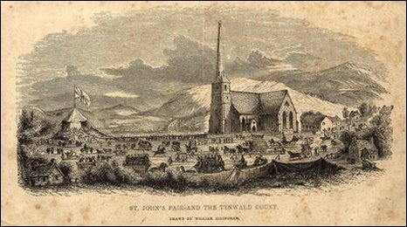
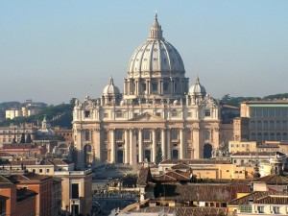
Continuity and Tradition
Notes:
It is an old and comfortable remark that the nation state – and by extension national libraries – are a product of the mid-nineteenth century. Of the thirty three bodies which have survived for almost a thousand years in Europe – certainly from the early Middle Ages - one is the Papacy; one is the Althing (the Parliament of Iceland); one is the Tynwald (the Parliament of the Isle of Man) and twenty-nine are universities. For continuity, for adaptability, for perseverance in ever changing political and societal environments, universities are second to none. In part that was because the form of the university stayed fundamentally unchanged for most of that thousand years. Manuscript drawings of lecture theatres and scriptoria, seventeenth century prints of libraries and twentieth century photographs of earnest students studying show an unchanging world. The young men (and later women) of Europe ate, drank, brawled and studied in the same way in 1269 as in 1962. The great scholars and thinkers of the day from Galileo and Erasmus to Einstein and Stephen Hawking held university appointments.

Slide 4
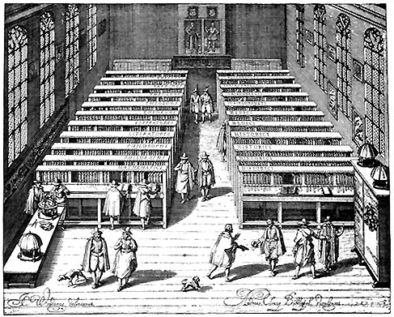
The University Library 1425 - 1975

Slide 5
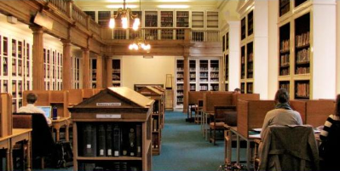
King James Library, University of St Andrews (1410)
Notes:
This picture shows the library in the 1970s at St Andrews, still occupying the rooms it took over in the seventeenth century – although the study carrels are more modern. Of course St Andrews University was founded in 1410 which allows us to think of Leuven as a new or at least newer university not having been founded until 1425. The point is, of course that for over 500 years, the great European University Libraries remained almost unchanged not only in how they looked, but in how they worked. But the 1960s and 1970s heralded a period of unprecedented change, a period which the former Bodley’s Librarian and our contemporary Reg Carr described thus. ‘Those who have worked in academic research libraries since the mid-1990s have been through a time of “white water” change such as none of their predecessors ever knew’. Within the span of a single professional career this part of the university community has experienced a period of quite unparalleled seismic change which shows no sign of abating. The very raison d’être of libraries is open to question while the skill set required appears to change almost by the week.
From the 1960’s to the end of the 1980’s library automation focused on making printed collections more readily available. The great pre-occupation of the profession was the retrospective conversion of catalogues. Almost without exception the entire university passed through the doors of the library. No serious researcher, scholar or undergraduate could work without the collections of the library and the inter-library loan service. There was as yet no national library service and very little co-operation with other libraries beyond the local. According to the Dempsey Paradox (Dempsey,2010) this was the time when researchers were time rich and information poor, so that local collections had to be mined exhaustively and librarians who knew the collections in detail were integral to research. International co-operation and travel existed, but remained unusual. That had begun to change by the mid-1980’s as the novelist David Lodge perceptively noted in his 1984 novel Small World:
"...information is much more portable in the modern world than it used to be. So are people. Ergo, it's no longer necessary to hoard your information in one building, or keep your top scholars corralled in one campus. There are three things which have revolutionized academic life in the last twenty years, though very few people have woken up to the fact: jet travel, direct-dialling telephones and the Xerox machine. Scholars don't have to work in the same institution to interact, nowadays: they call each other up, or they meet at international conferences. And they don't have to grub about in library stacks for data: any book or article that sounds interesting they have Xeroxed and read it at home. Or on the plane going to the next conference. I work mostly at home or on planes these days. I seldom go into the university except to teach my courses.
...As long as you have access to a telephone, a Xerox machine and a conference grant fund, you're OK, you're plugged into the only university that really matters - the global campus. A young man in a hurry can see the world by conference-hopping" (Lodge,1984)
Let me recall that world and what was happening

Slide 6
The End of Libraries
“The Librarians and Libraries
that do not accept the change
will inevitably be victims of the
evolution. For the dinosaurs it
will indeed be the end.
James Thompson
“We are already very close to
the day in which a great science
Library could exist in a space
Less than 10 feet square
F W Lancaster
Notes:
The fireside myths of library history tell of a resolute four thousand year journey through change: from the oral tradition through the great library of Ashurbanipal with its tablets of stone to papyri then the monastic scriptoria. Then we moved on to Gutenberg and the printed word and further development into sound and film collections. The profession comforts itself that throughout these four thousand years we have often been buffeted by the great waves of change, but never yet capsized. Librarians are adept at finding comforting statistics showing that the slumbering power of libraries remains real. A recent report from OCLC (OCLC, 2003) recorded that:
- There are five times as many library cards as Amazon users;
- there are more libraries than McDonald’s outlets in the USA;
- one person in six in the world is a registered library user;
- there are over one million libraries and over 700,000 librarians
worldwide.
But universities and certainly university libraries have changed more and more rapidly in the span of the last twenty years than in in the last five hundred. The fulcrum of that change was the creation of the World Wide Web in 1993 and a dramatic transformation in the nature of content, the nature of authority and trust and the nature of teaching and learning. The sheer volume of data as well as its ubiquity has transformed the ordered world of libraries and poses a set of challenges which herald a very different world for information professionals.
And yet, if we return to first principles we may find that the goals, if not the tools, of our profession remain much as they always were. To paraphrase very lightly the precepts of Ranganathan, perhaps the most famous of library philosophers we are still charged with getting the right information to the right user at the right time.

Slide 7
Microsoft’s View
http://www.microsoft.com/mscorp/tc/scholarly_communication.mspx
Notes:
And it is arguably true that libraries have failed.
Look at this recent slide from Microsoft, describing the scholarly life cycle

Slide 8
The failure of Librarians
Making the technology work too well
Libraries have hidden the complexity
Lack of underpinning philosophy
No strong theoretical base of e-librarianship
Rise of the managerial technocrat
From partnership to servitude
Driving down costs
Complacency
Libraries are eternal
Failure to engage with e-resources
Obsessed with licences
Digitising oddities = cabinets of curiosities

Slide 9
Notes:
Lets look briefly at some of that new content

Slide 10
Data mining
The NEXT BIG THING
But it’s all information
Large scale data sets from science
Noisy text sets from humanities
Integration of access to audio, video, images and text
3D representation

Slide 11
Collaborative research
Blue Obelisk
Open Wetware
nanoHUB
High resolution remote artefacts
Pooled research
Sermo
Open Communities such as Innocentive
Nature Precedings

Slide 12
Forms of e-content
Research papers
Conference presentations
Theses
Wikis
Blogs
Websites
Podcasts
Reusable Learning Objects
Research data
E-Lab books
Streamed lectures
Images
Audio files
Digitised collections
E-Archives
E-mail
HR Records
Student/Staff records
Corporate publications
National heritage artefacts
Notes:
No university has a policy

Slide 13
Ten Word Wiki
Librarian: Superhero who can find anything. Penchant for cats and cardigans.
Prague: The heart of Europe, beset by tourists, no cheap taxis.
China: Most populous country on Earth. Communist place with tasty food.
Notes:
Perhaps the ultimate if slightly tongue in cheek application for this attention deficit disorder generation is the Ten Word Wiki. Rather like the haiku it attempts to distil if not wisdom then at least information in exactly ten words.

Slide 14
“Climategate: University of East Anglia U-turn in climate change row”
Climate change email scandal shames the university and requires resignations. (The Guardian)
Climate change: this is the worst scientific scandal of our generation. (The Telegraph)
Notes:
As research environments become more complex, it seems sensible to explore how far scientists can manage their own infrastructure and how far they need support to manage this, in exactly the same way as estates professionals, human resources professionals and health and safety professionals manage elements of research support. What seems destined to become a classic case of not managing information happened in 2009-10 at the University of East Anglia, where the science underpinning climate change was challenged because the information had not been properly managed. This need to manage information has in some libraries led to a revisiting of the concept of the subject librarian now described as ‘embedded’. There is even a neat coinage of ‘feral’ librarians for those working in librarian positions but without library qualifications. Kesselman and Watstein (2009) judge that ‘embedded librarianship is one of the prime tenets of a user-centered library’. It is only by experiencing at first hand exactly how users manage their information, their information seeking and their workflows that librarians can begin to design and offer services which truly add value and are responsive.

Slide 15
The Good Old Days……..
Notes:
This picture of a lecture is taken from the Liber_ethicorum_des_Henricus_de_Alemannia.It shows how in universities the transmission of knowledge from teacher to student has also stayed unchanged for a thousand years.
But both users and content have changed

Slide 16
“This is not an incremental change but a discontinuity”
Digital natives and digital immigrants
Changed behaviour patterns
Prensky, Marc (2001) Digital Natives,
Digital Immigrants
On the Horizon Vol. 9 No. 5, pp1-6
Prensky, Marc (2001a) Digital Natives, Digital Immigrants Part 2: Do they really think differently?
On the Horizon Vol. 9 No. 6, pp1-6
CIBER (2007) Information
Behaviour of the Researcher of
the Future. London: CIBER.
Online at http://www.bl.uk/news/pdf/googlegen.pdf
Notes:
Today’s students – K through college – represent the first generations to grow up with this new technology. They have spent their entire lives surrounded by and using computers, videogames, digital music players, video cams, cell phones, and all the other toys and tools of the digital age. Today’s average college grads have spent less than 5,000 hours of their lives reading, but over 10,000 hours playing video games (not to mention 20,000 hours watching TV). Computer games, email, the Internet, cell phones and instant messaging are integral parts of their lives.”
Prensky 2001

Slide 17
The Environment
Changing student habits
Changing research methods
Fragmentation of resource
Financial pressures
Failure of librarians
Instant and universal gratification
Notes:
I want to talk about how the environment has changed around us and look at these points in more detail.
Technology has led to a situation where time is precious and information must be delivered instantaneously.
As Freddie Mercury sang, “I want it all and I want it now”.
Unsurprisingly research has been dramatically changed by technology whether from the sheer volume of data or the use of social networks to share research
Students are equally affected by technology and new forms of pedagogy
Financial pressures may not be a new problem but they do sharpen the need to work smarter and be more attuned to client needs
Librarians have been wonderfully adept at managing ever more complicated organisations and have become skilled at managing the daily routine. But I will argue that they have failed to stand back and understand the underlying changes which require new ways of thinking as well as new ways of working.
And finally there is a huge fragmentation of resources caused by the internet and by the ability of anyone and everyone to post untested and partial information. The whole system of trusted authorities has been overturned and wikipedia and Google have become the dominant arbiters of information.
Each of these issues requires more detailed consideration

Slide 18
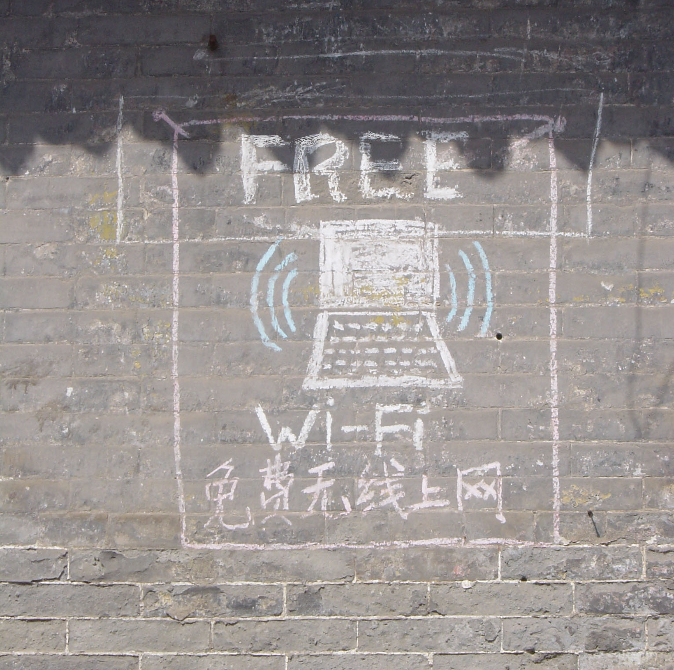
Notes:
Copyright Derek Law. A hostel wall in Pingyao, China
It is easy to forget that today’s twenty-one year olds spring entirely from a digital world. John Naughton pithily described this in the Observer (Naughton, 2006). For today's twenty-one year olds born in 1991 the Internet was seven years old which was five years after Nintendo launched 'Super Mario Brothers', the first blockbuster game. As they went to school, Tim Berners-Lee was busy inventing the World Wide Web, which emerged as a phenomenon as they were in secondary school. The Palm Pilot was launched at the same time. Also at that time, pay-as-you-go mobile phone tariffs arrived, enabling teenagers to have phones. Napster and Blogger.com were launched in 1999, while they were at primary school. The iPod and the early social networking services appeared in 2002, when they were entering secondary school. Skype launched in 2003, and YouTube launched in 2005, as they were heading towards GCSEs.

Slide 19
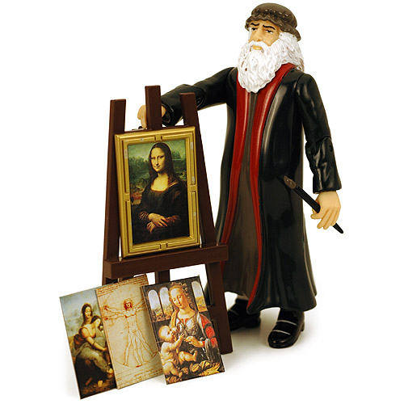
Action Man: Available from All Good Bookshops…..
Leonardo da Vinci
was the original
Renaissance man.
He was a master of
painting, science,
language and the
inspiration for
Leonardo Di Caprio’s
name
Notes:
19
Taken from Internet. Commercial product in various sale catalogues
1. In part what I want to talk about today is changes in the nature of scholarship. This is not to be confused with dumbing down, but is in my view a slow but inexorable shift in the tectonic plates of scholarly communication. Now of course dumbing down does exist. Just before Christmas, and for the first time, I felt moved to complain at my local Waterstone’s about the products on sale.
2. Action Man: Available from All Good Bookshops…..
I understand that an Einstein Action Man also exits. Happily they removed it, although it’s still available on the Internet.

Slide 20
Digital Natives (1)
Expect research to be easy and feel they can be independent in the process.
They do not seek help from librarians and only occasionally from professors or peers.
When they can’t find what they need, they give up and assume that the information cannot be found. Students often stop after their initial searches thinking they have completed the research process and fail to choose a particular focus.
Notes:
20
CIBER studies
The notion that the world is changing fundamentally and that the digital natives have arrived is hardly novel, but once it enters the heart of the establishment we must grant a new gravitas to the presumption of such change. The way in which church and state have both arrived at this conclusion now leaves little room for the sceptic. The Catholic Church has adopted this view. For World Communications Day 2010, Pope Benedict XVI has developed the notion of cyber priests. He proposed a new commandment for priests struggling to get their message across: ‘Go forth and blog’. The Pope, whose own presence on the Web has grown massively in recent years, urged priests to use all multimedia tools at their disposal to preach the Gospel. This message can be found not only on Facebook, but also on the papal website Pope2You.

Slide 21
Digital Natives: An Inexorable Trend (2010-11)
The Internet generation don’t have the attention span for jury duty says the Lord Chief Justice
European children aged 2-5 lead their U.S. counterparts in knowing how to make a mobile phone call (44% in Italy vs. 25% for the U.S.), playing a computer game (70 %U.K. vs. 61%U.S.) and operating a mouse (78%France vs. 67% U.S.)
One in three children write their present lists to Santa using a website or smartphone app
More kids aged 2-5 can play with a smartphone app (19%) than tie their shoelaces (9%)
More small children can open a web browser (25%) than swim unaided (20%)
Notes:
Young people make bad jurors because they find it hard to concentrate for long periods, according to the most senior judge in England and Wales. The so-called 'internet generation' are so used to information presented on a screen that they are unable to listen to complex arguments in a courtroom, said the Lord Chief Justice, Lord Judge of Draycote.
In a speech, he said most younger people today are 'technologically proficient', consulting the internet for much of their information.
But he warned: 'They are not listening; they are reading. One potential problem is whether, learning as they do in this way, they will be accustomed, as we were, to listening for prolonged periods.'
Alton Towers Santa Sleepover Survey in Metro via Katherine Wolfson of Alton Towers
‘Digital Diaries’ study from Internet Security Company AVG (www.avg.com). AVG Digital Diaries is a series of studies looking at how children's interaction with technology has changed.

Slide 22
ChildWise Annual Survey 2008
40% of 9year olds have internet in their room
They have six hours of screen time a day, with 1.7 hours online
“2008 has seen a major boost in intensity”
Reading for pleasure has declined from 84% to 74% in two years
They are fluent communicators who don’t read and rely on spellcheckers
They multitask
They are abandoning print and paper and communicate in a
completely different way
Notes:
As reported in the Guardian http://www.guardian.co.uk/media/2009/jan/19/internet-generation-parents

Slide 23
The Dempsey Paradox
The Internet has reversed information seeking from:
Time rich/ information poor
Information rich/time poor

Slide 24
Digital Immigrants
Send postcards on holiday
Buy CDs
Watch TV programmes at the time they are shown
Check a map for a car journey
Own an encyclopaedia or dictionary
Buy newspapers
Notes:
Survey dated 11 December 2011 on fifty tasks killed by technology
http://mozy.co.uk/news/releases/technology-tolls-the-death-knell-for-time-honoured-traditions/

Slide 25
The Good Old Days……..
Notes:
By Maurice William Greiffenhagen British artist, 1862 - 1931

Slide 26
Cabinets of Curiosities
Digitising the Collections we have does not of itself add value
The need to add value is often ignored
Aggregation
Cataloguing
Folksonomy
Mash-ups
Ignoring the born digital

Slide 27
Facing the Future
Adding Value for the User
Adding Value to the Content
Adding Value to the Staff
Adding Value for the Institution

Slide 28
Library/Information service challenges
Information is ephemeral:
44% of websites disappear within a year
Wikipedia not Britannica will be the norm
User not expert created
Democratic not authoritative
We need to manage information and access to it NOT just store it
EXCEPT, we need to digitise, curate and make available corporately owned or created content
Information fluency is a critical skill

Slide 29
Adding Value to Teaching
Webcasting
Wikis
User created content
Content Management
Podcasts
iTunesU

Slide 30
Law’s Second Law
User
Friendly
Systems
Aren’t

Slide 31
Adding Value to Content
Don’t compete with Google
Identify the niche to occupy
Use Google tools
Improve Wikipedia
Where are Special Collections?
Where is eg Orwell Archive
Bibliographic Integrity
Version control
Metadata
Improving access
Aggregation
Leader or follower

Slide 32
Notes:
Screen capture

Slide 33
Sarah Thomas and manuscripts

Slide 34
Adding Value to Staff
Social networking
Staff CPD
Professional engagement at all levels
The conference test
23 Library 2.0 things
http://plcmc2-about.blogspot.com/

Slide 35
Adding value to the institution
The Green Agenda
How much does the Library cost
http://www.greenlibraries.org/
Learning spaces

Slide 36
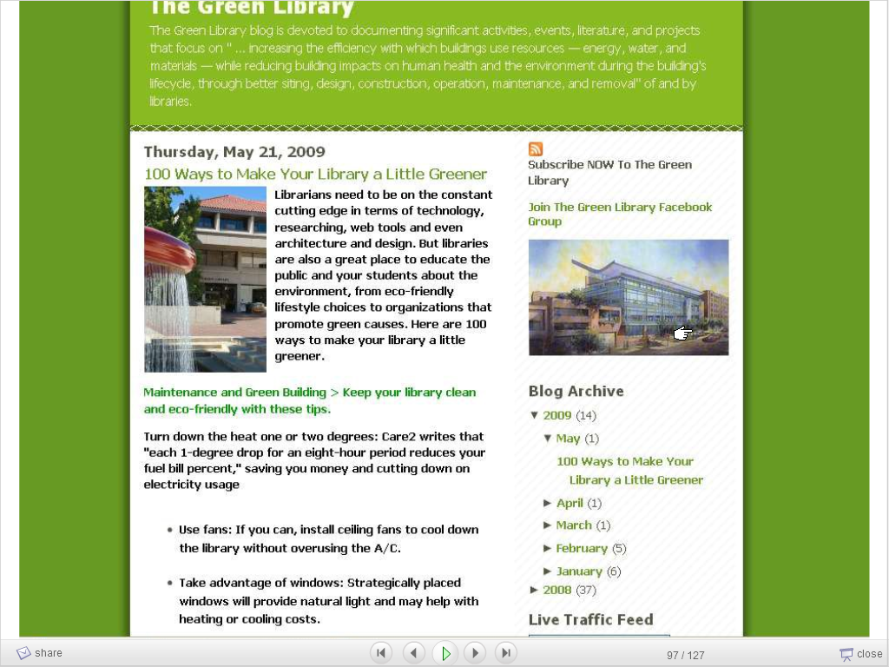

Slide 37
Trusted repositories: the five Maori tests
Receive the information with accuracy
Store the information with integrity beyond doubt
Retrieve the information without amendment
Apply appropriate judgement in the use of the information
Pass the information on appropriately

Slide 38
The future of information management
Activities
Examples
Preservation
Description
Aggregation
Adding Value
Corporate Support
Marketing
User Support
Digital Curation
Audit trails
Information Management
Information Governance and Compliance
League Tables
East Anglia
Notes:
Preservation: Media from computer games to the spoken word. Transient technologies
Description: making things accessible
Aggregation: Europeana and TEL. Major
Adding Value: GPS; crowdsourcing, translation and subtitling
User Support: User Friendly Systems aren’t
How to get it wrong: East Anglia Case

Slide 39
Valuable – or invaluable?
Advocacy and Partnership
Business Processes
Collections
Digital Library
Estates
Fundraising – with whom?
Resource Discovery
Staffing
Storage
User support
Leader or follower in initiatives
External help
Born digital
What is the strategy
Green agenda
Only money? Part of the whole? Alumni?
Trust metrics
Fewer better paid?
Cooperation
Anytime, Any place, Anywhere

Slide 40
The OCLC analysis
The Library was created as a set of activities to minimise transaction costs.
Now that it’s all on the web, can we shift transaction costs?
Move on from that to see what categories of function are distinctive: CRM, product innovation and content aggregation.
Vanilla stuff should be outsourced.
Notes:
Discussion with Lorcan Dempsey

Slide 41
The agenda for libraries
Building e-Research collections and contributing to a virtual research environment of born digital material
Importance of kite marking, quality assurance, trust metrics and relevance ranking
Managing institutional born digital assets and making content available
Value added content
Disciplinary support through training/information literacy
Policy and standards advice

Slide 42
Digital Overlap Strategy
Notes:
42

Slide 43
Always Expect the Unexpected
Notes:
My copyright

